Slide 1
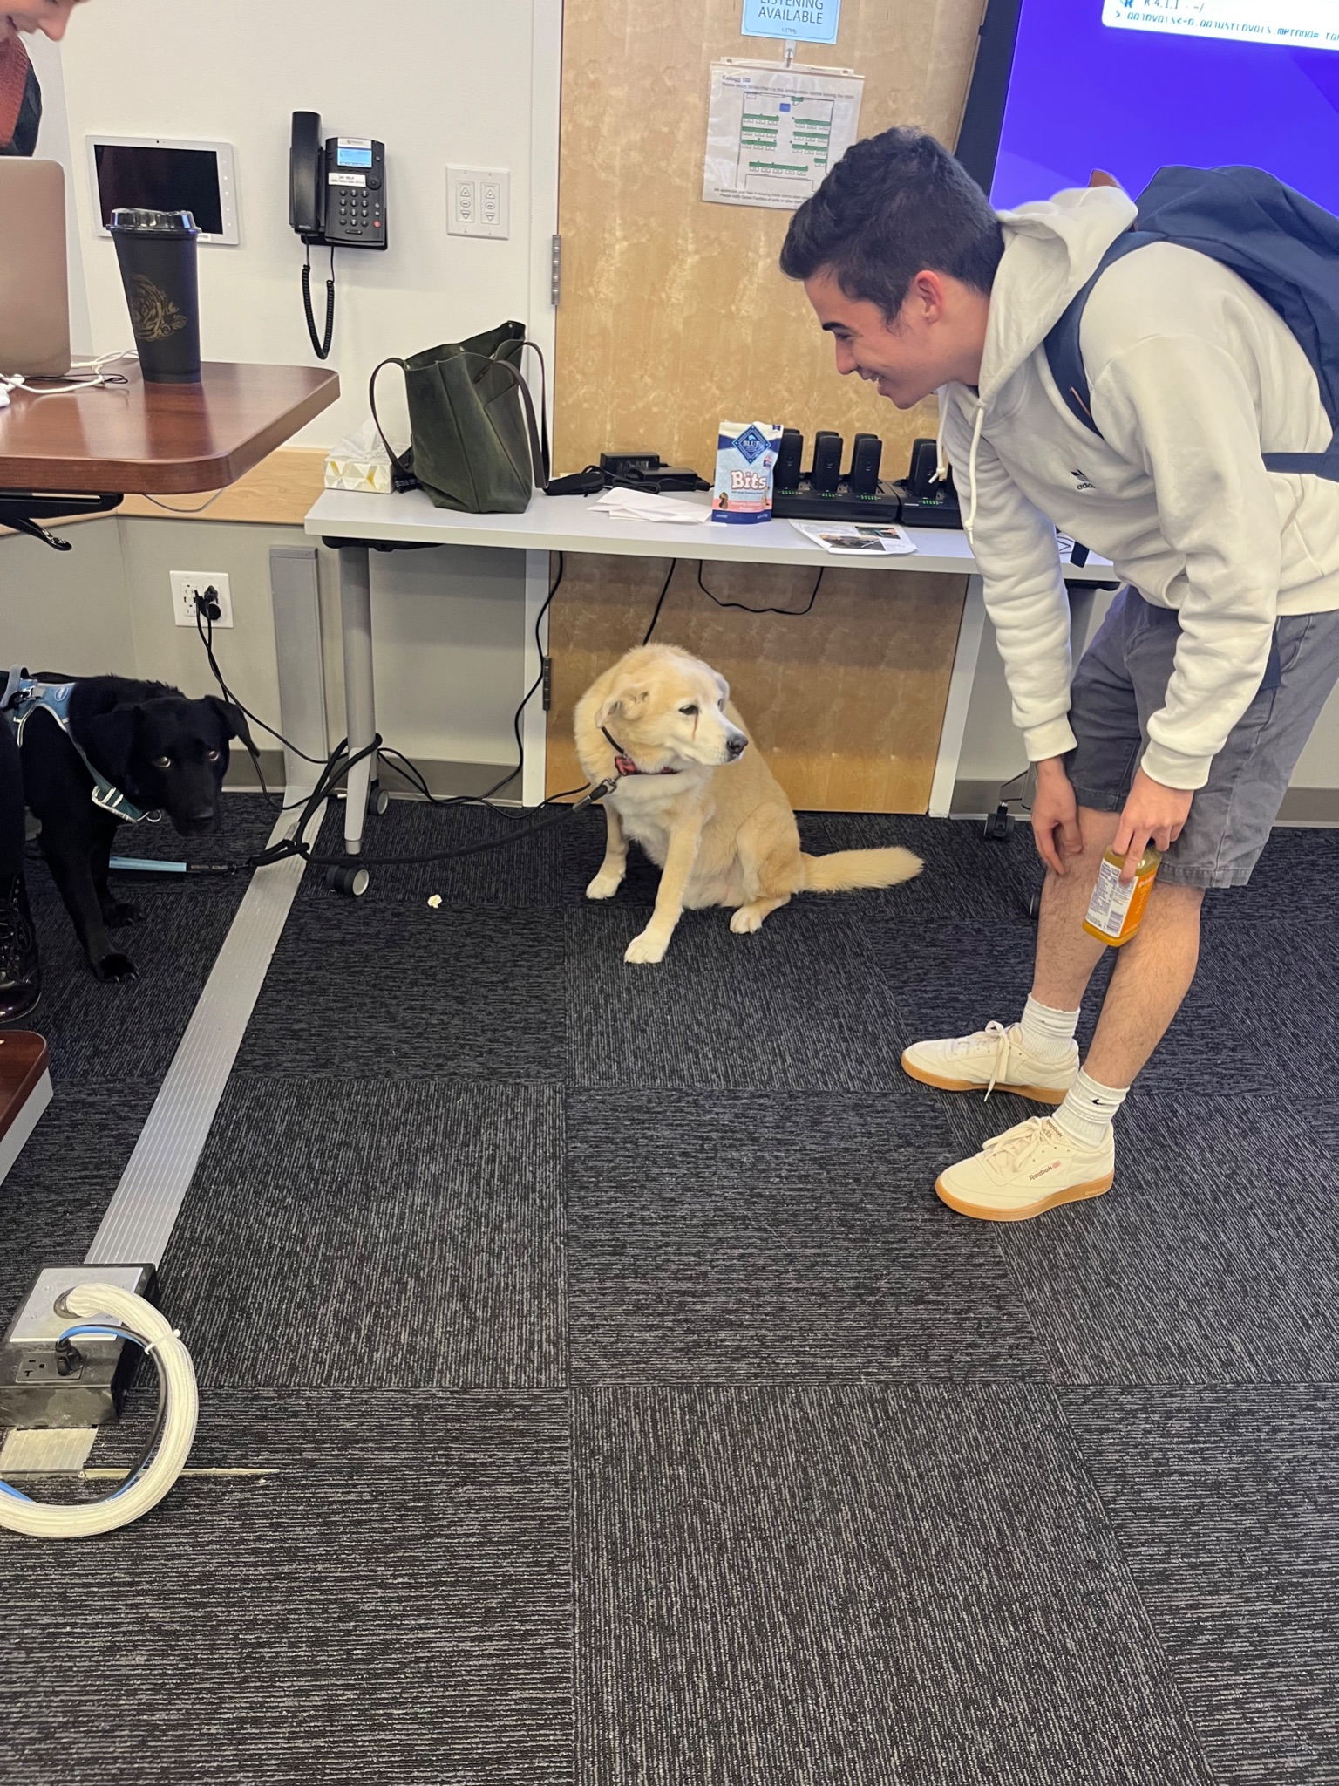
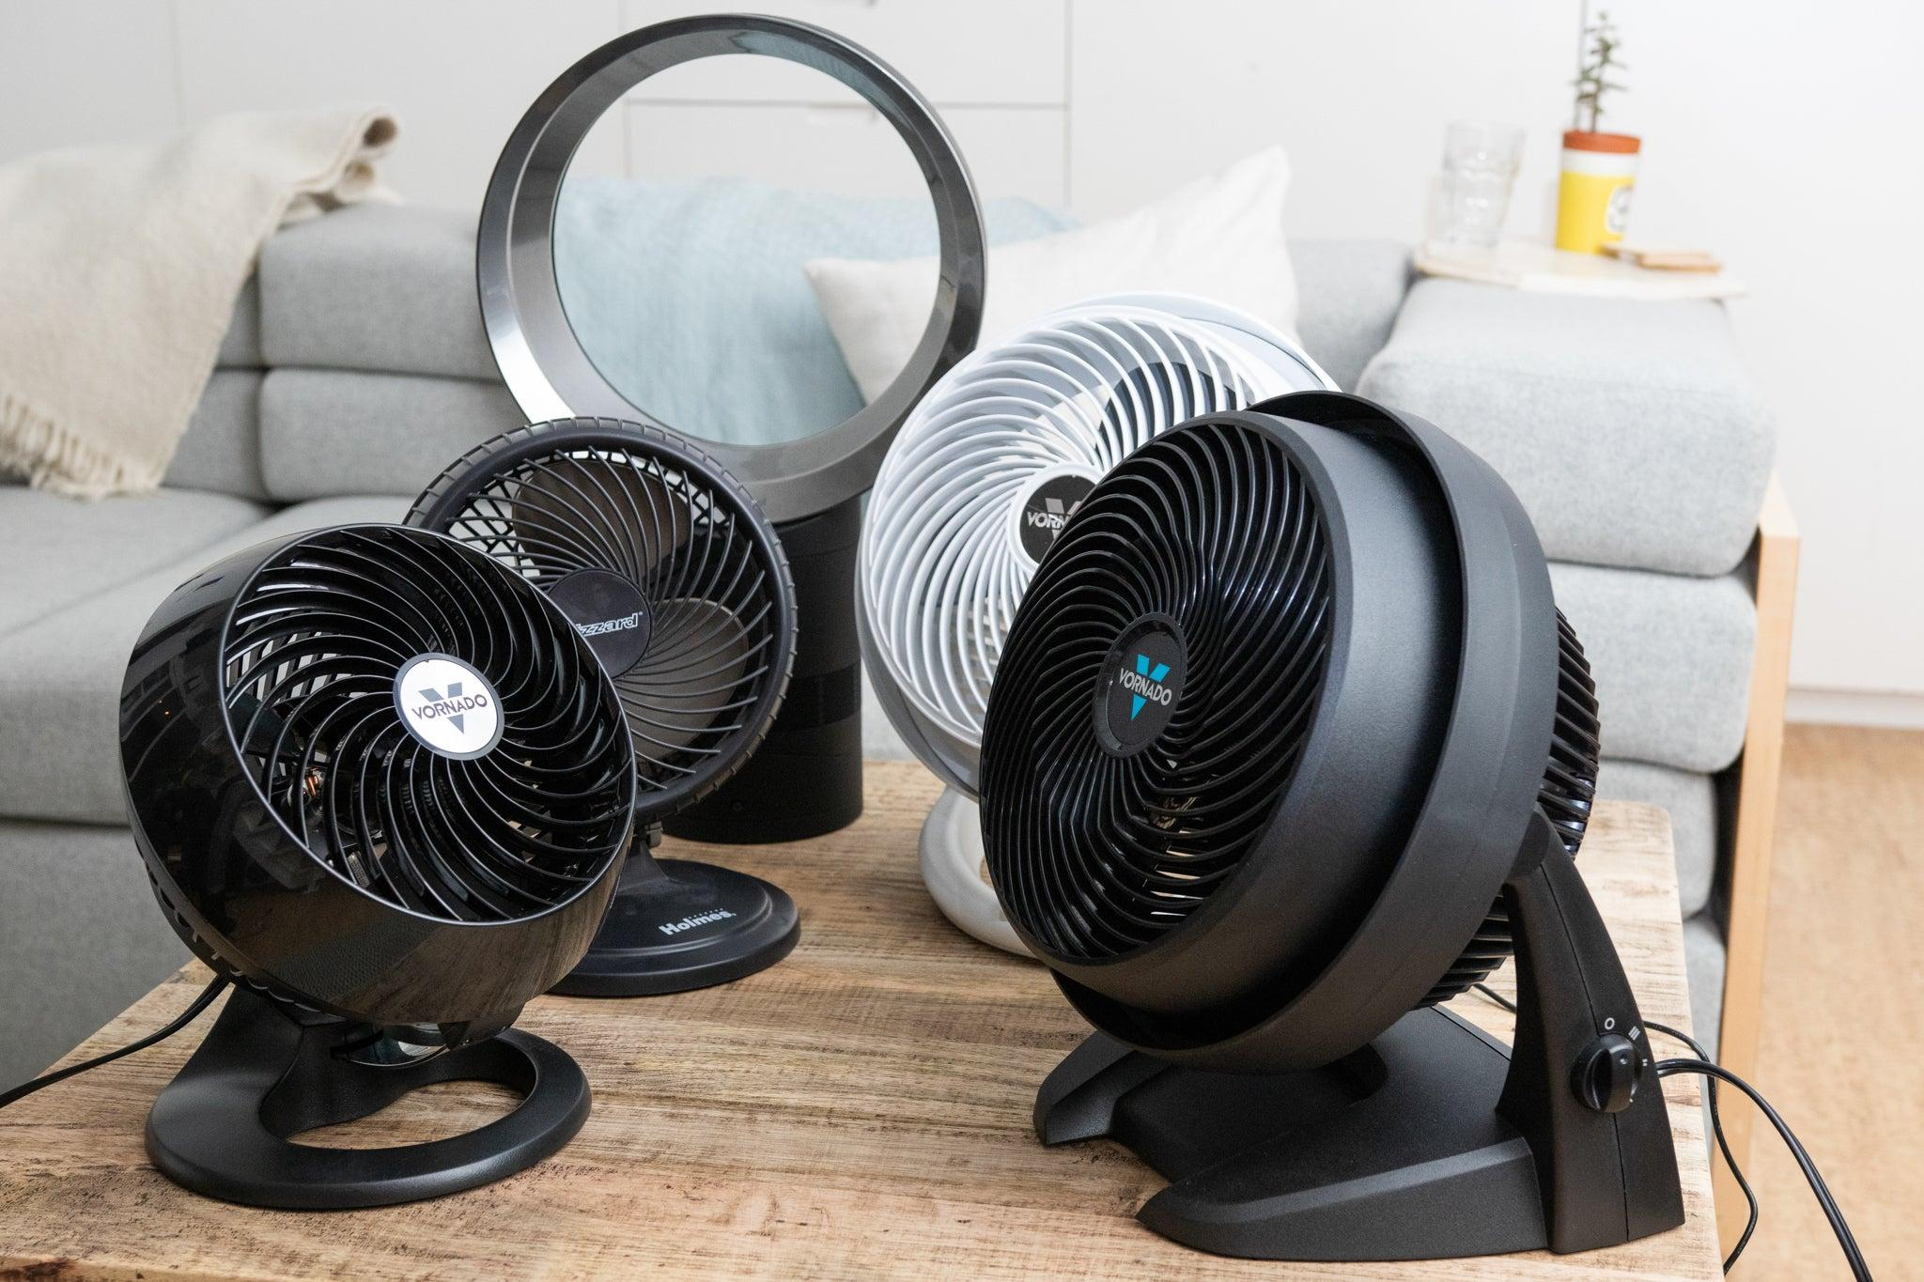
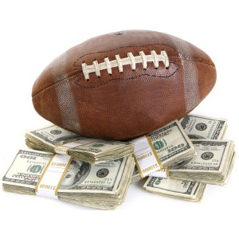
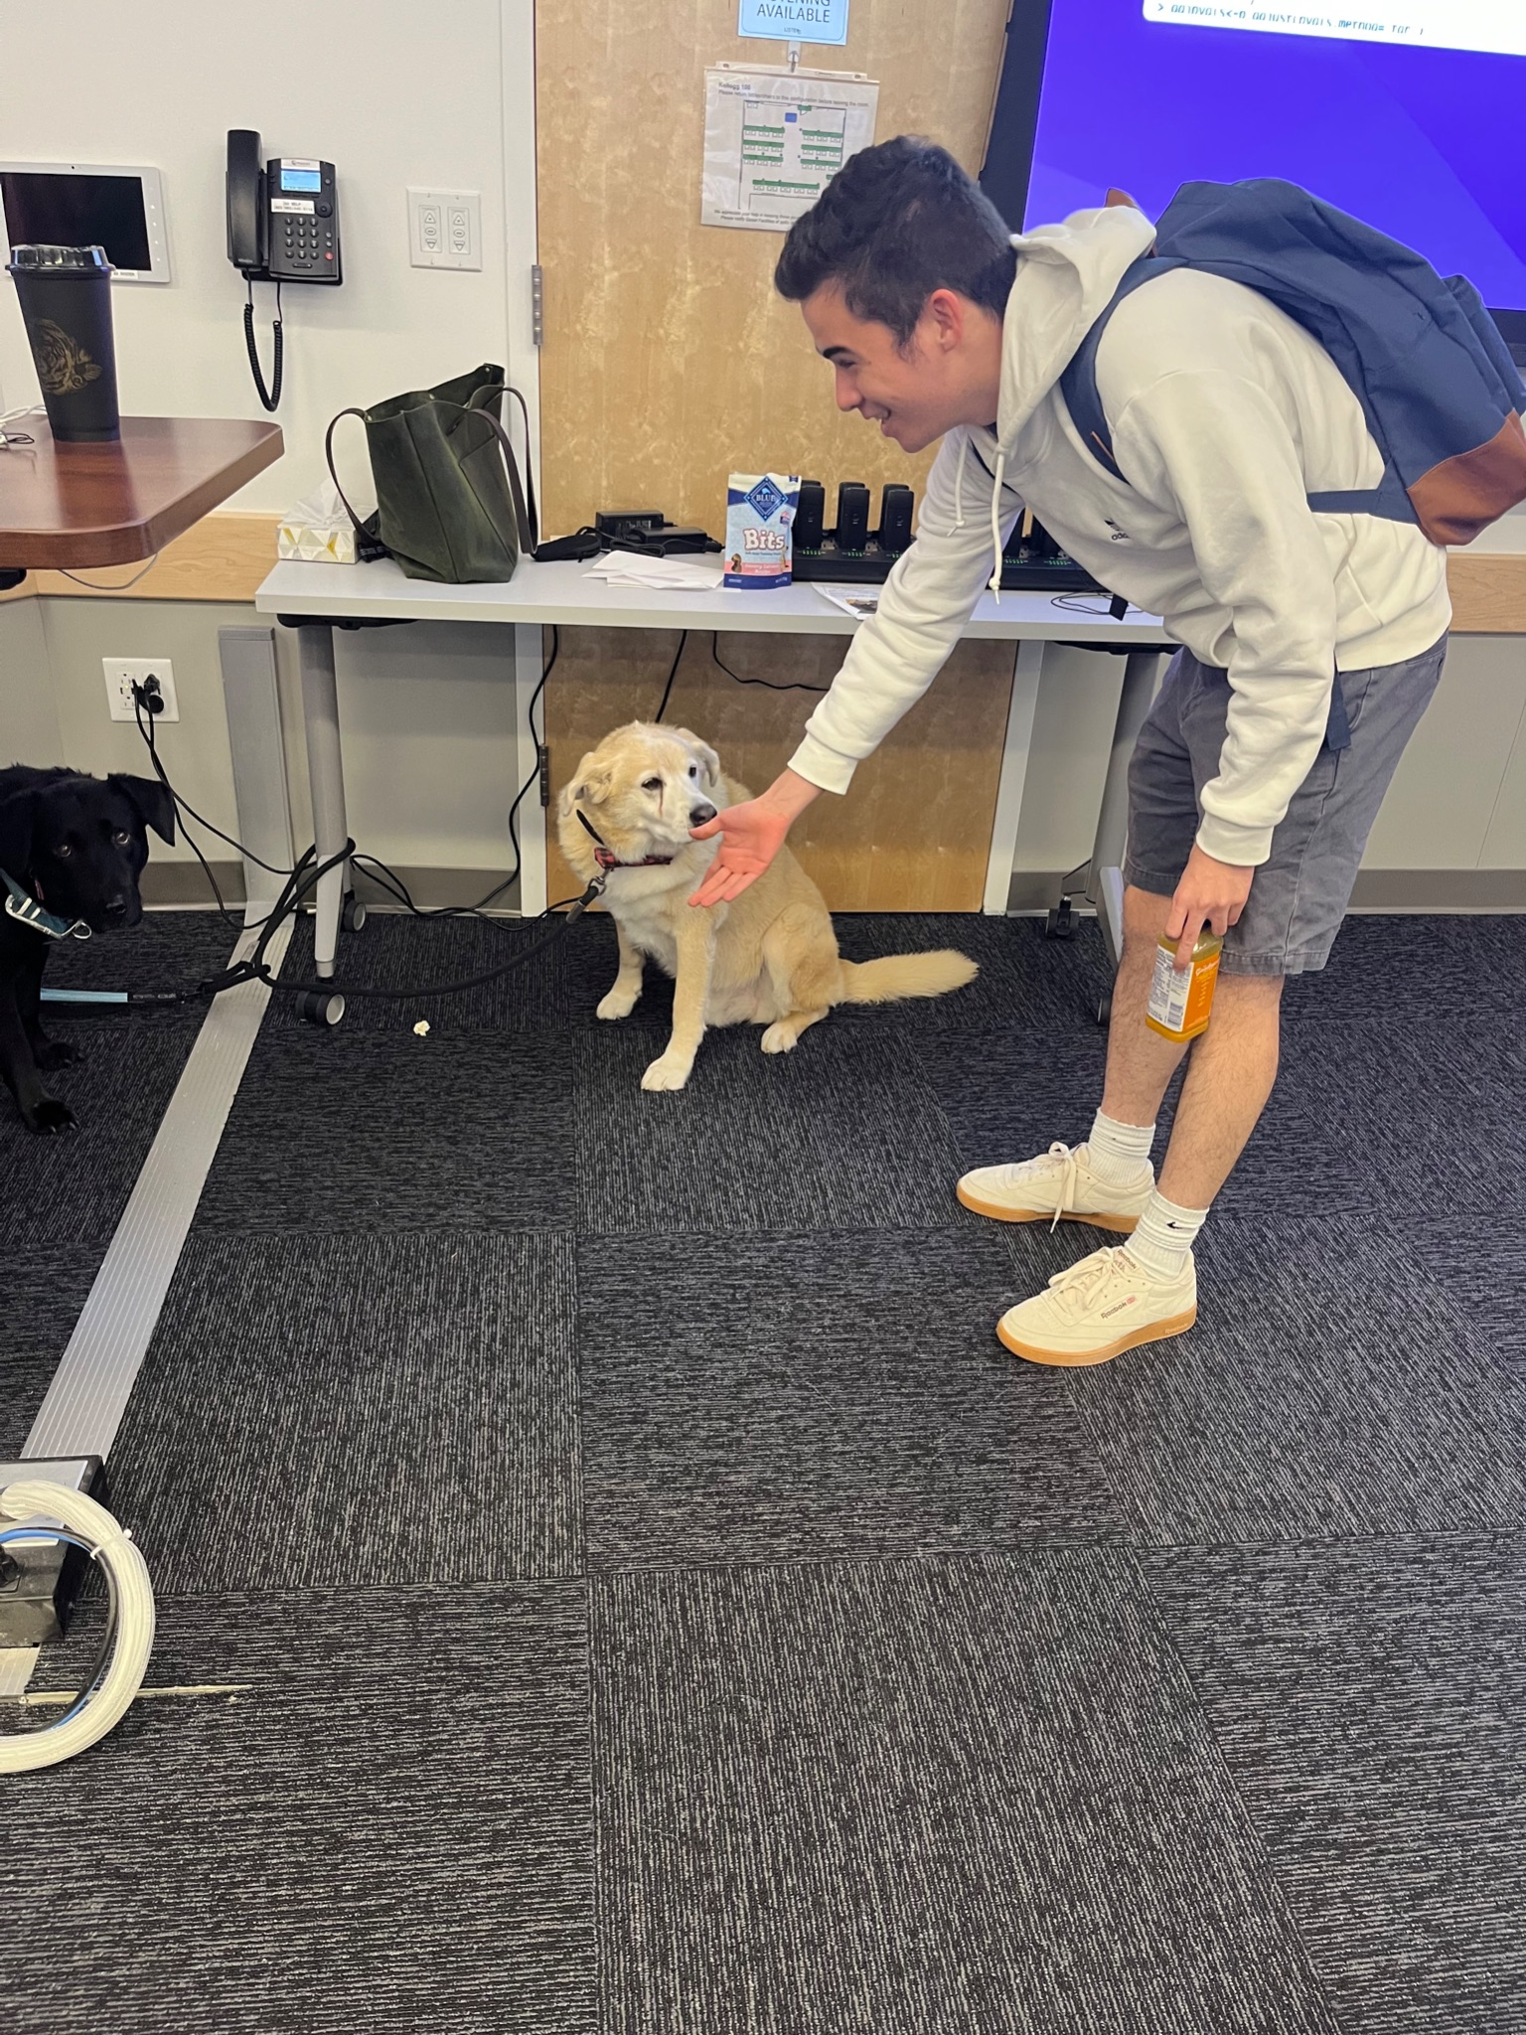
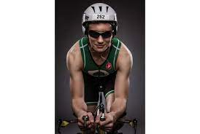
Sports Betting: How Have the Books Done Over Time?
By: Bofan (Will) Chen, Joe Gyorda, Anton Hung, Sean Pietrowicz, and Kevin Rouse (TeamDougFans)
With help from Carly, Doug, and Shrey

Slide 2
Overview
Introduction and Motivation
Data Wrangling Methods
Data Acquisition
Excel Data Cleaning
Tidyverse Data Cleaning
Preliminary Analyses
Word Cloud and Exploratory Data Analysis
Missing Value Analysis
The effect of weather conditions on the accuracy of the betting spread
Advanced Modeling
Predictive modeling on the accuracy of the betting spread
Network model of team’s performance against spread
Web Scraping

Slide 3
Introduction and Motivation
(We already miss Doug)

Slide 4
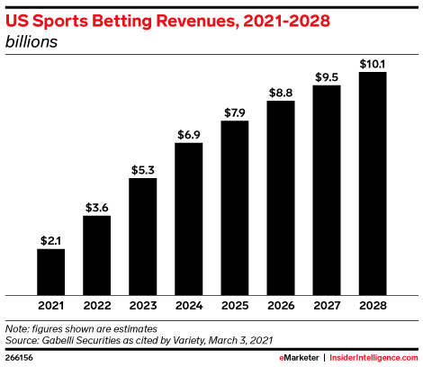

Introduction - Background
Introduction
Data Wrangling
Preliminary Analyses
Advanced Modeling
Web Scraping
https://www.insiderintelligence.com/content/sports-gambling-opportunity-marketers
https://www.techradar.com/news/fanduel-vs-draftkings

Slide 5
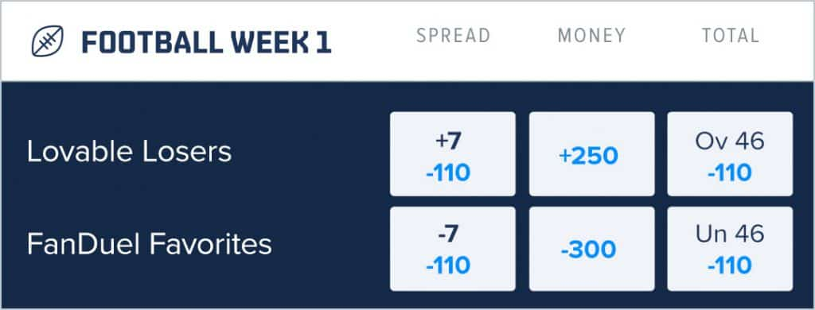
Brief Overview of Sports Betting
Introduction
Data Wrangling
Preliminary Analyses
Advanced Modeling
Web Scraping
Here, the FanDuel Favorites are a better team than the Lovable Losers
In order to make betting on the game fair, a spread is created (certain amount of points are added to worse team’s score or are subtracted from the better team’s score)

Slide 6
Introduction - What will we be analyzing?
Introduction
Data Wrangling
Preliminary Analyses
Advanced Modeling
Web Scraping
Aim 1: How has the accuracy of the spreads set by the books changed over time?
This will allow us to determine if the methods the bookmakers use are getting better and harder to compete with
Aim 2: Determine possible sources of volatility in spread accuracy
Does certain weather, team matchups, grass types, etc. affect the accuracy of the spreads
Can these factors be used to the bettors benefit to try and beat the books

Slide 7
Data Wrangling Methods

Slide 8
Methods - Data Acquisition
Introduction
Data Wrangling
Preliminary Analyses
Advanced Modeling
Web Scraping
Data is from kaggle.com
Contains 3 Different csv files
Spread Data
Includes date of game,home and away team, home and away score, favored team, and spread, weather, etc.
Team Data
Includes team name, abbreviation, division, and conference
Stadium Data
Includes stadium name and other information about the stadium such as grass type, climate, etc.

Slide 9
Methods - Excel Data Cleaning
Introduction
Data Wrangling
Preliminary Analyses
Advanced Modeling
Web Scraping
Raw data did not include results of the game relative to the spread, and a series of VLOOKUPs and IF statements were needed to determine the result of the game relative to the spread
Added a column which was actual result of game - predicted result(spread)
Did same procedure for the over/under in game versus predicted
Merged stadium and team data using VLOOKUPs

Slide 10
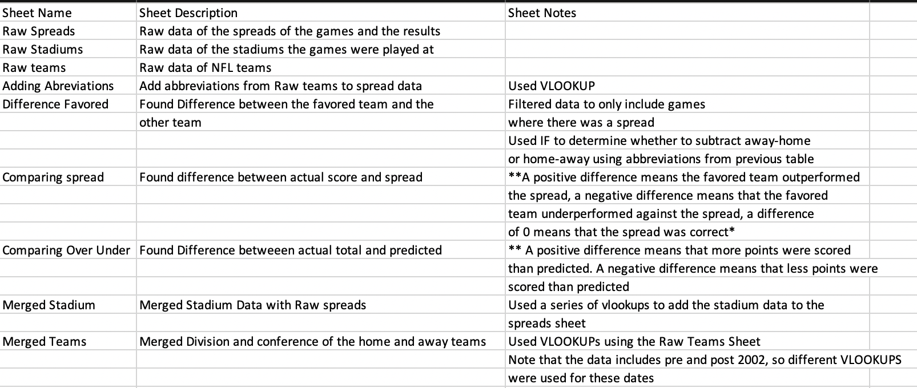
Introduction
Data Wrangling
Preliminary Analyses
Advanced Modeling
Web Scraping

Slide 11
Methods - Tidyverse Data Cleaning
Introduction
Data Wrangling
Preliminary Analyses
Advanced Modeling
Web Scraping
Adding Abbreviations: Select columns, Rename column and Save the dataframe as df1, Do a left join for spreads by df1
Difference Favored: Use ifelse function to create new variable difference_favored_minus_notfavored
Comparing Spread: Take the absolute value of spread_favorite, and then difference favored minus this absolute value
Comparing Over Under: score_home+score_away-over_under_line
Merge Stadium: Rename column stadium in table stadium, Merge spread by doing a left join with stadium
Merge Teams: Select columns in table teams, Rename column, Do a left join

Slide 12
Preliminary Analyses:
I. Word Cloud and Exploratory Data Analysis

Slide 13
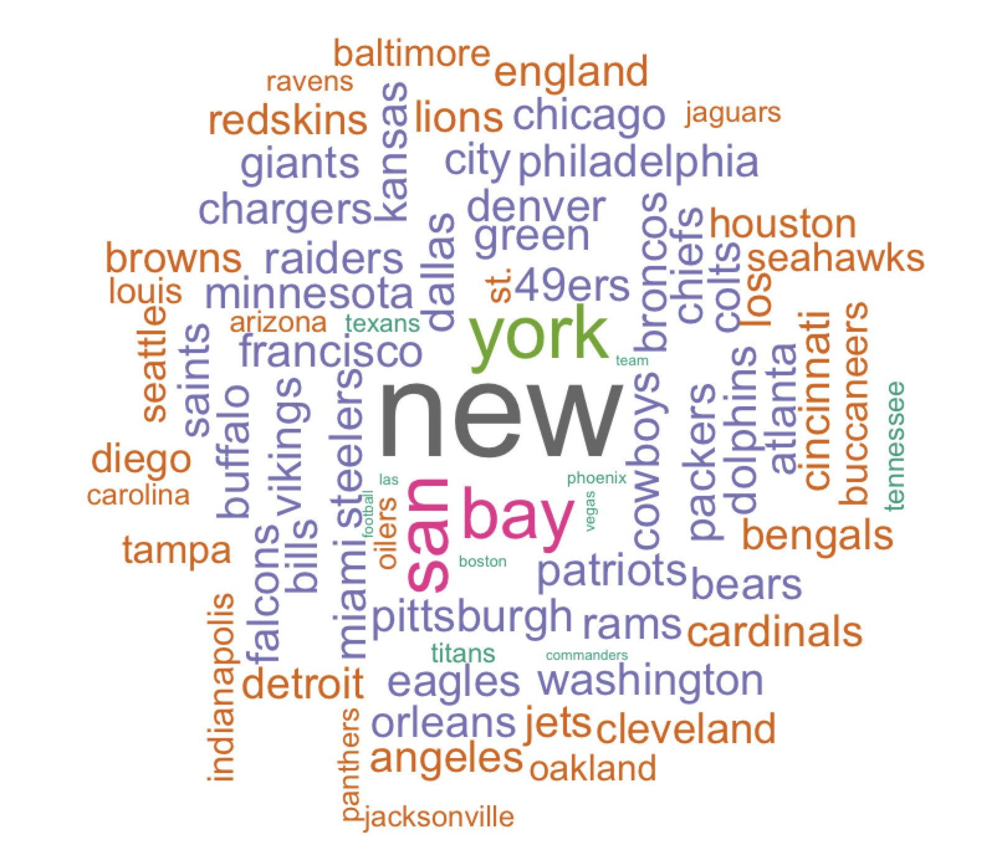
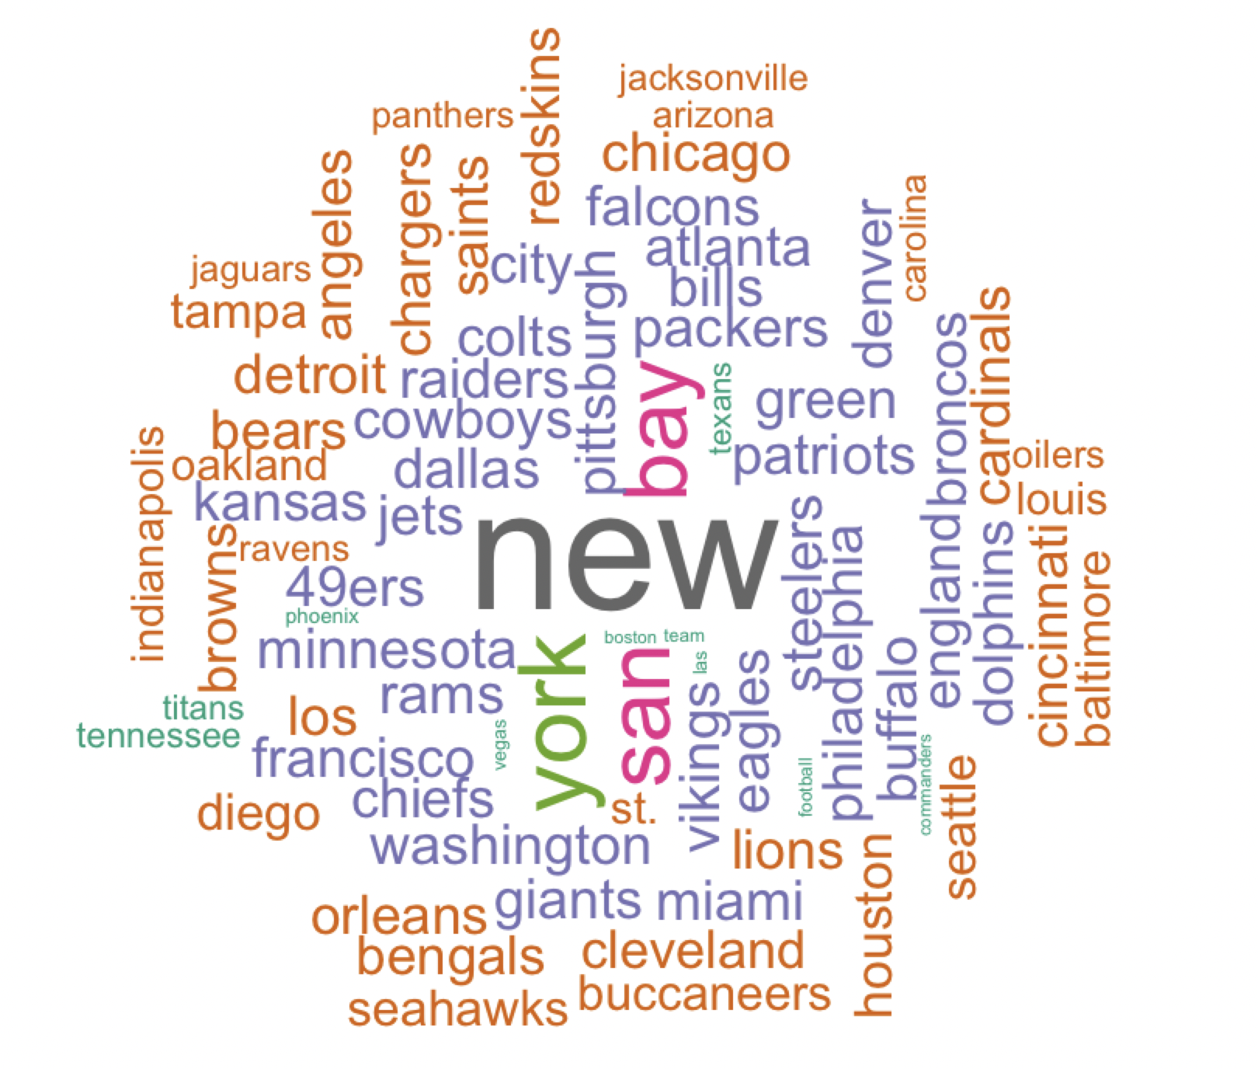
Word Cloud - Team
Introduction
Data Wrangling
Preliminary Analyses
Advanced Modeling
Web Scraping
team_home
team_away

Slide 14
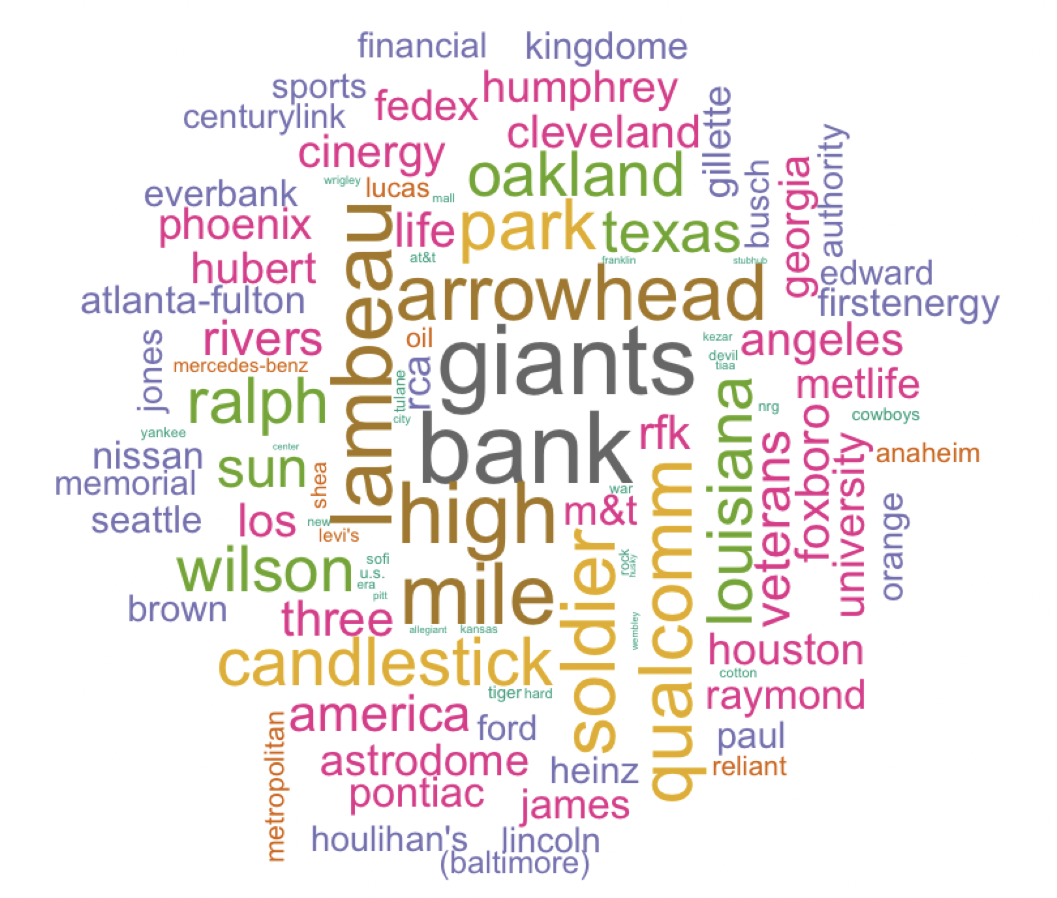
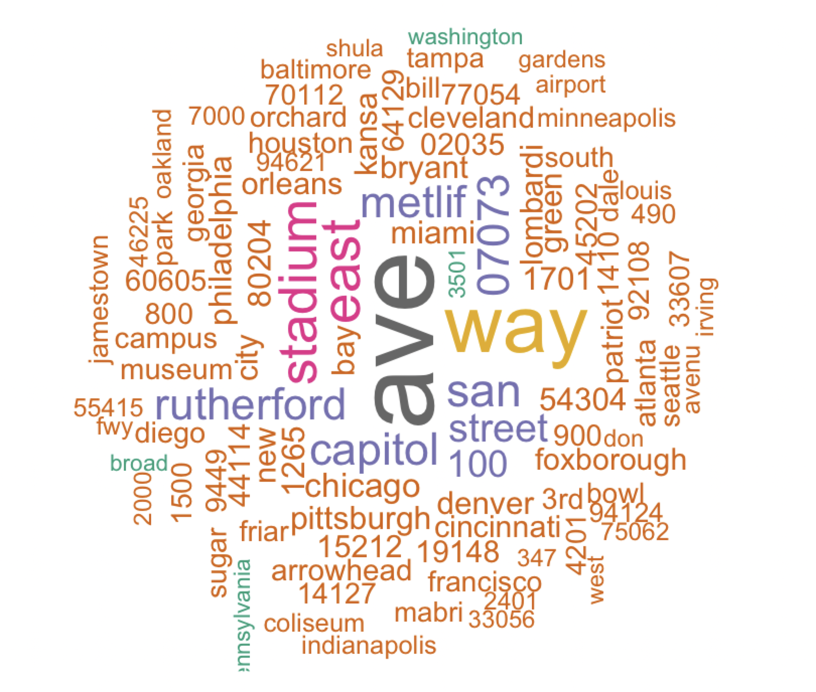
Word Cloud - Stadium
Introduction
Data Wrangling
Preliminary Analyses
Advanced Modeling
Web Scraping
stadium
stadium_address

Slide 15
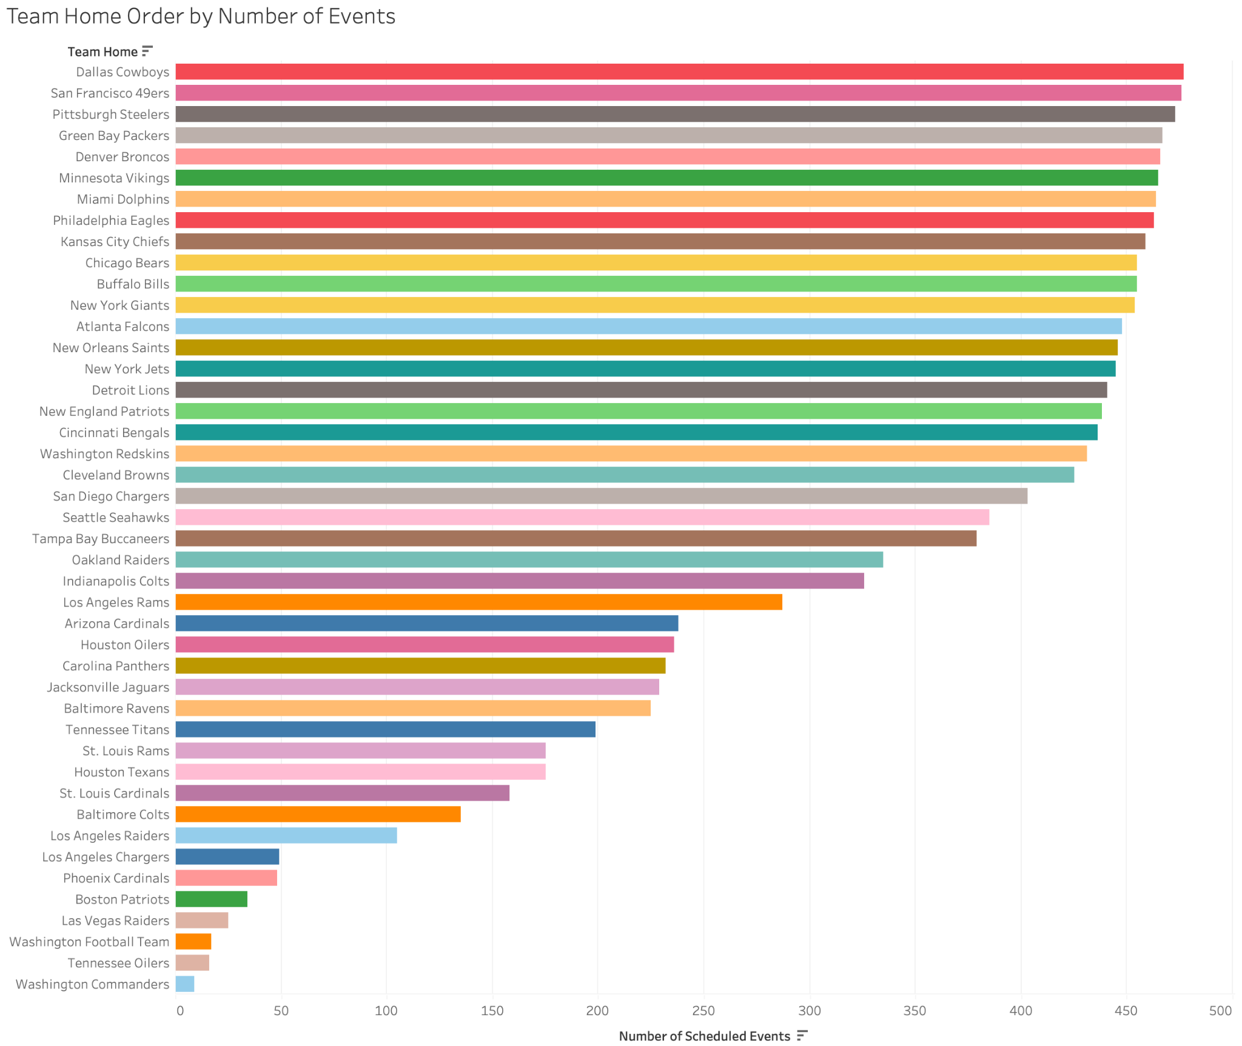
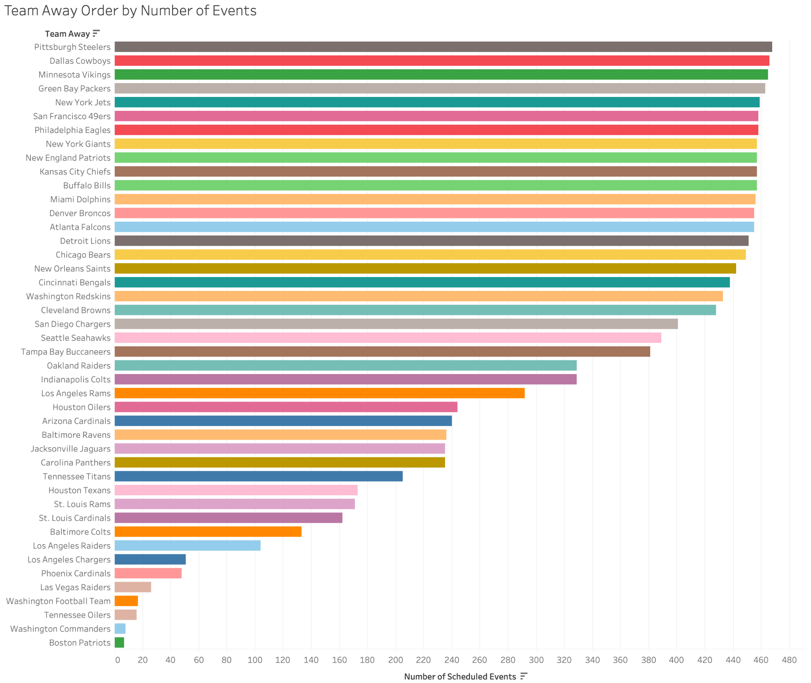
Exploratory Data Analysis - Team
Introduction
Data Wrangling
Preliminary Analyses
Advanced Modeling
Web Scraping

Slide 16
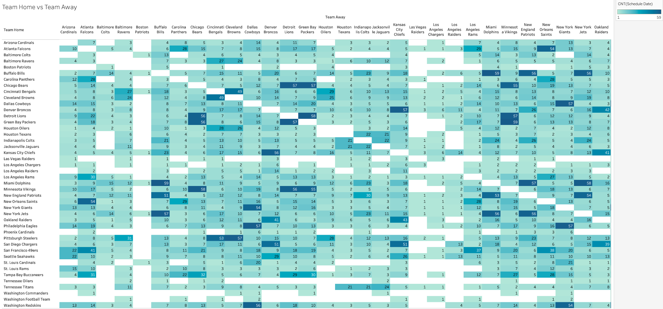
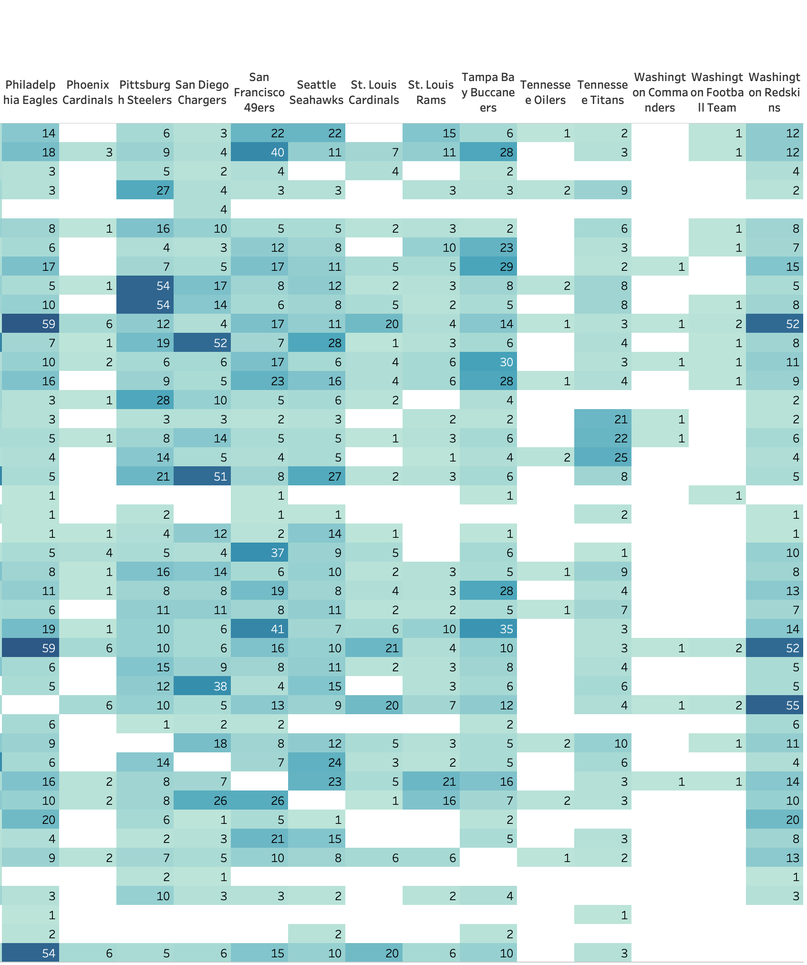
Exploratory Data Analysis - Team
Introduction
Data Wrangling
Preliminary Analyses
Advanced Modeling
Web Scraping

Slide 17
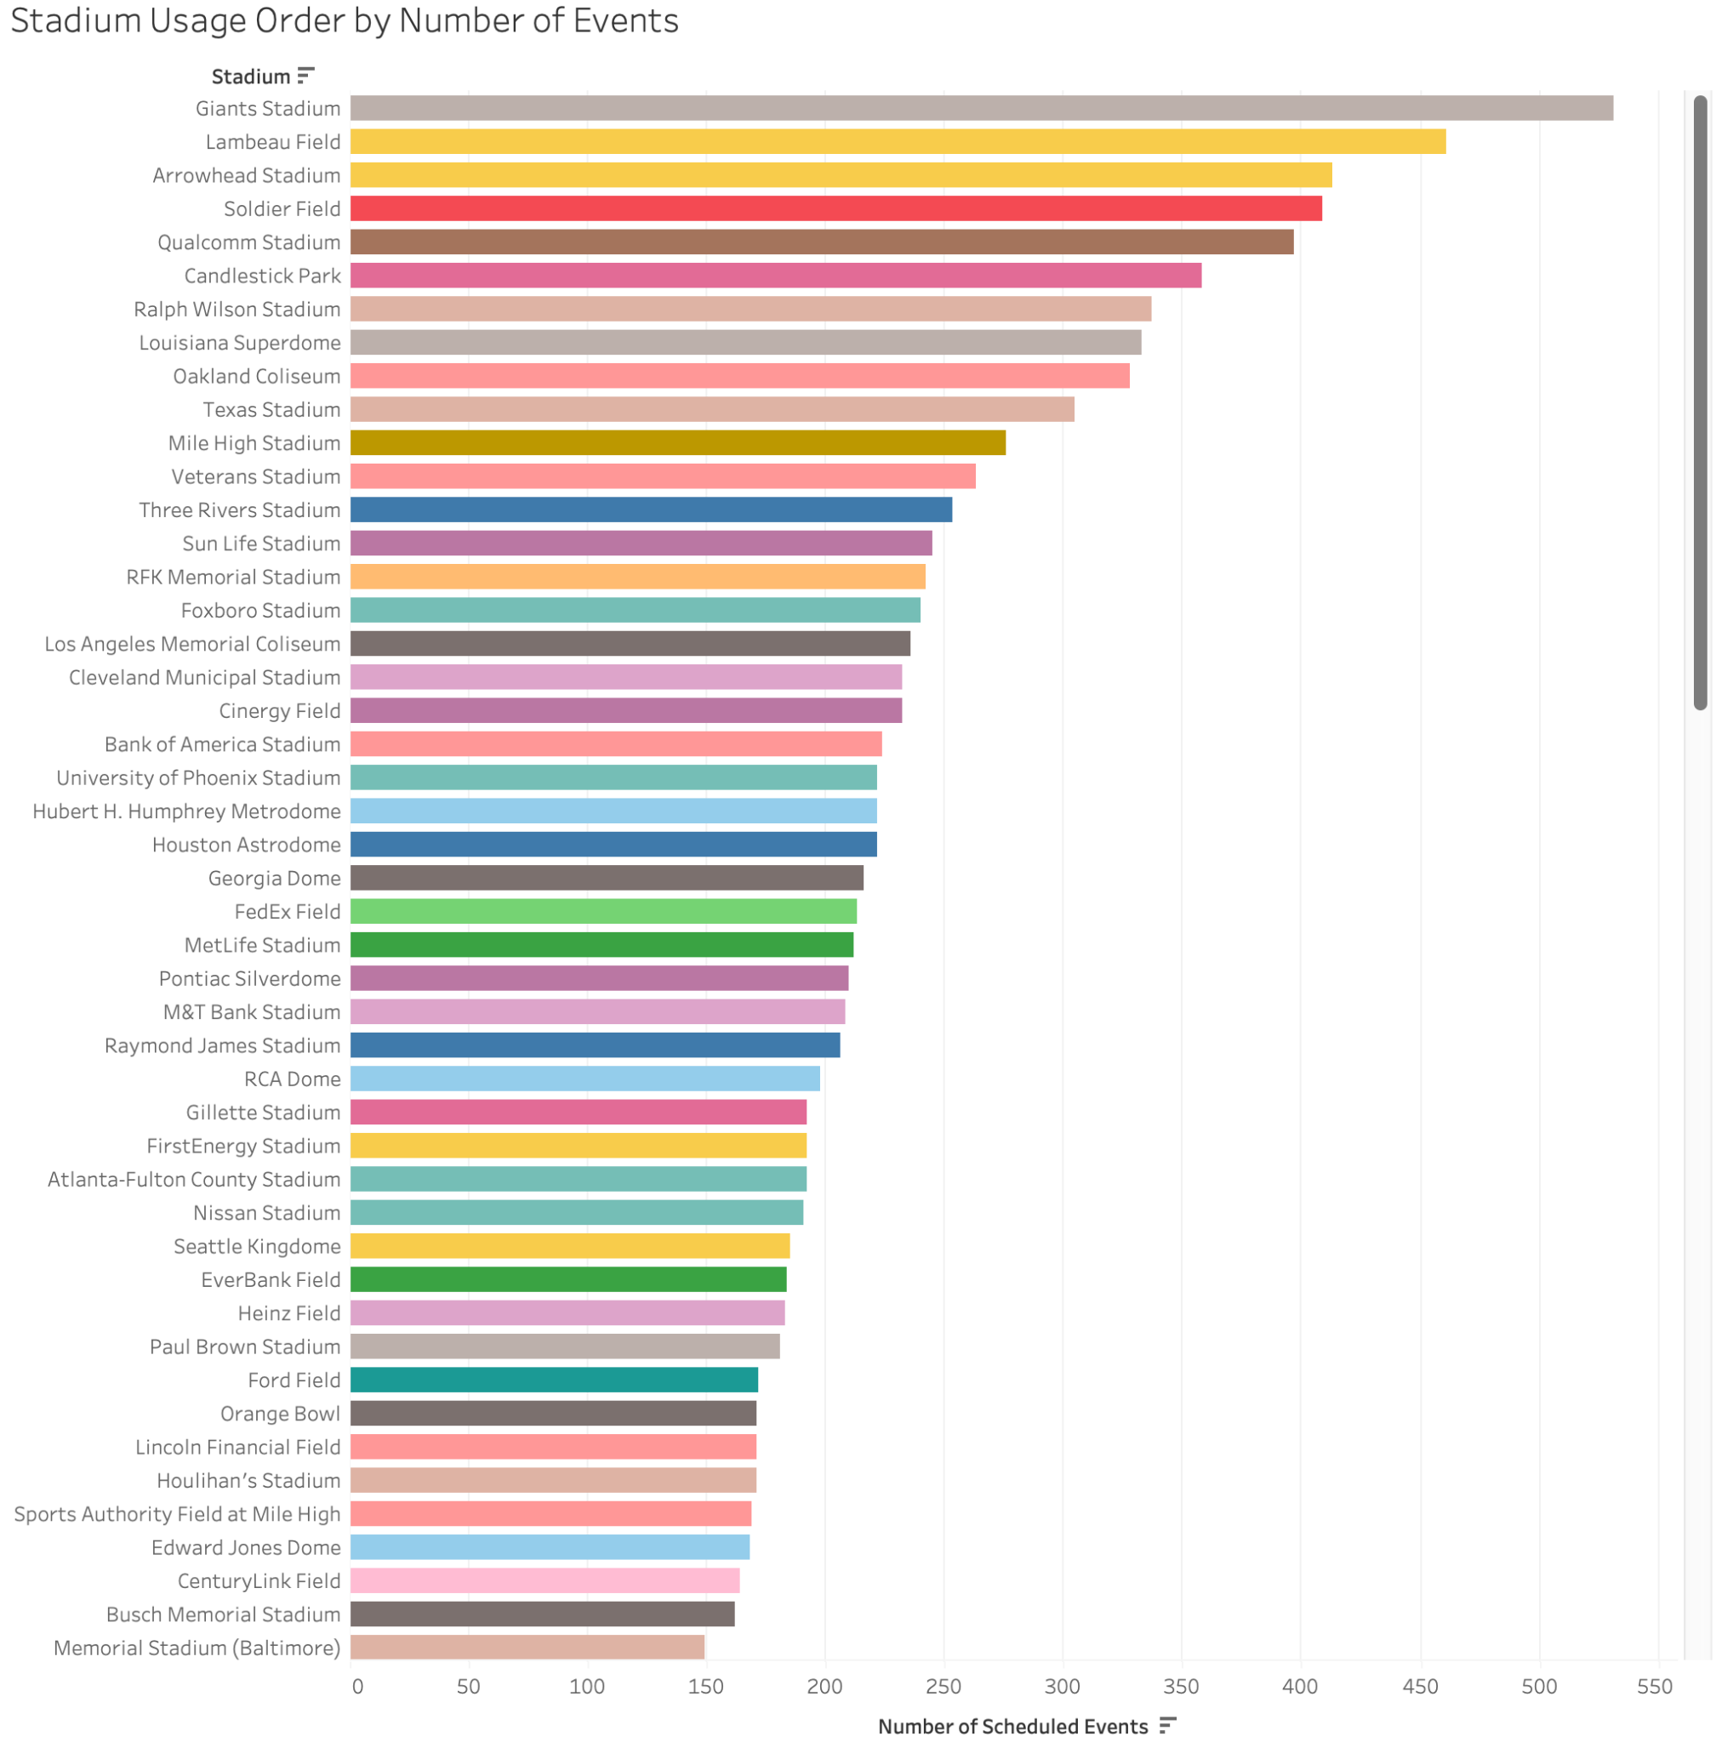
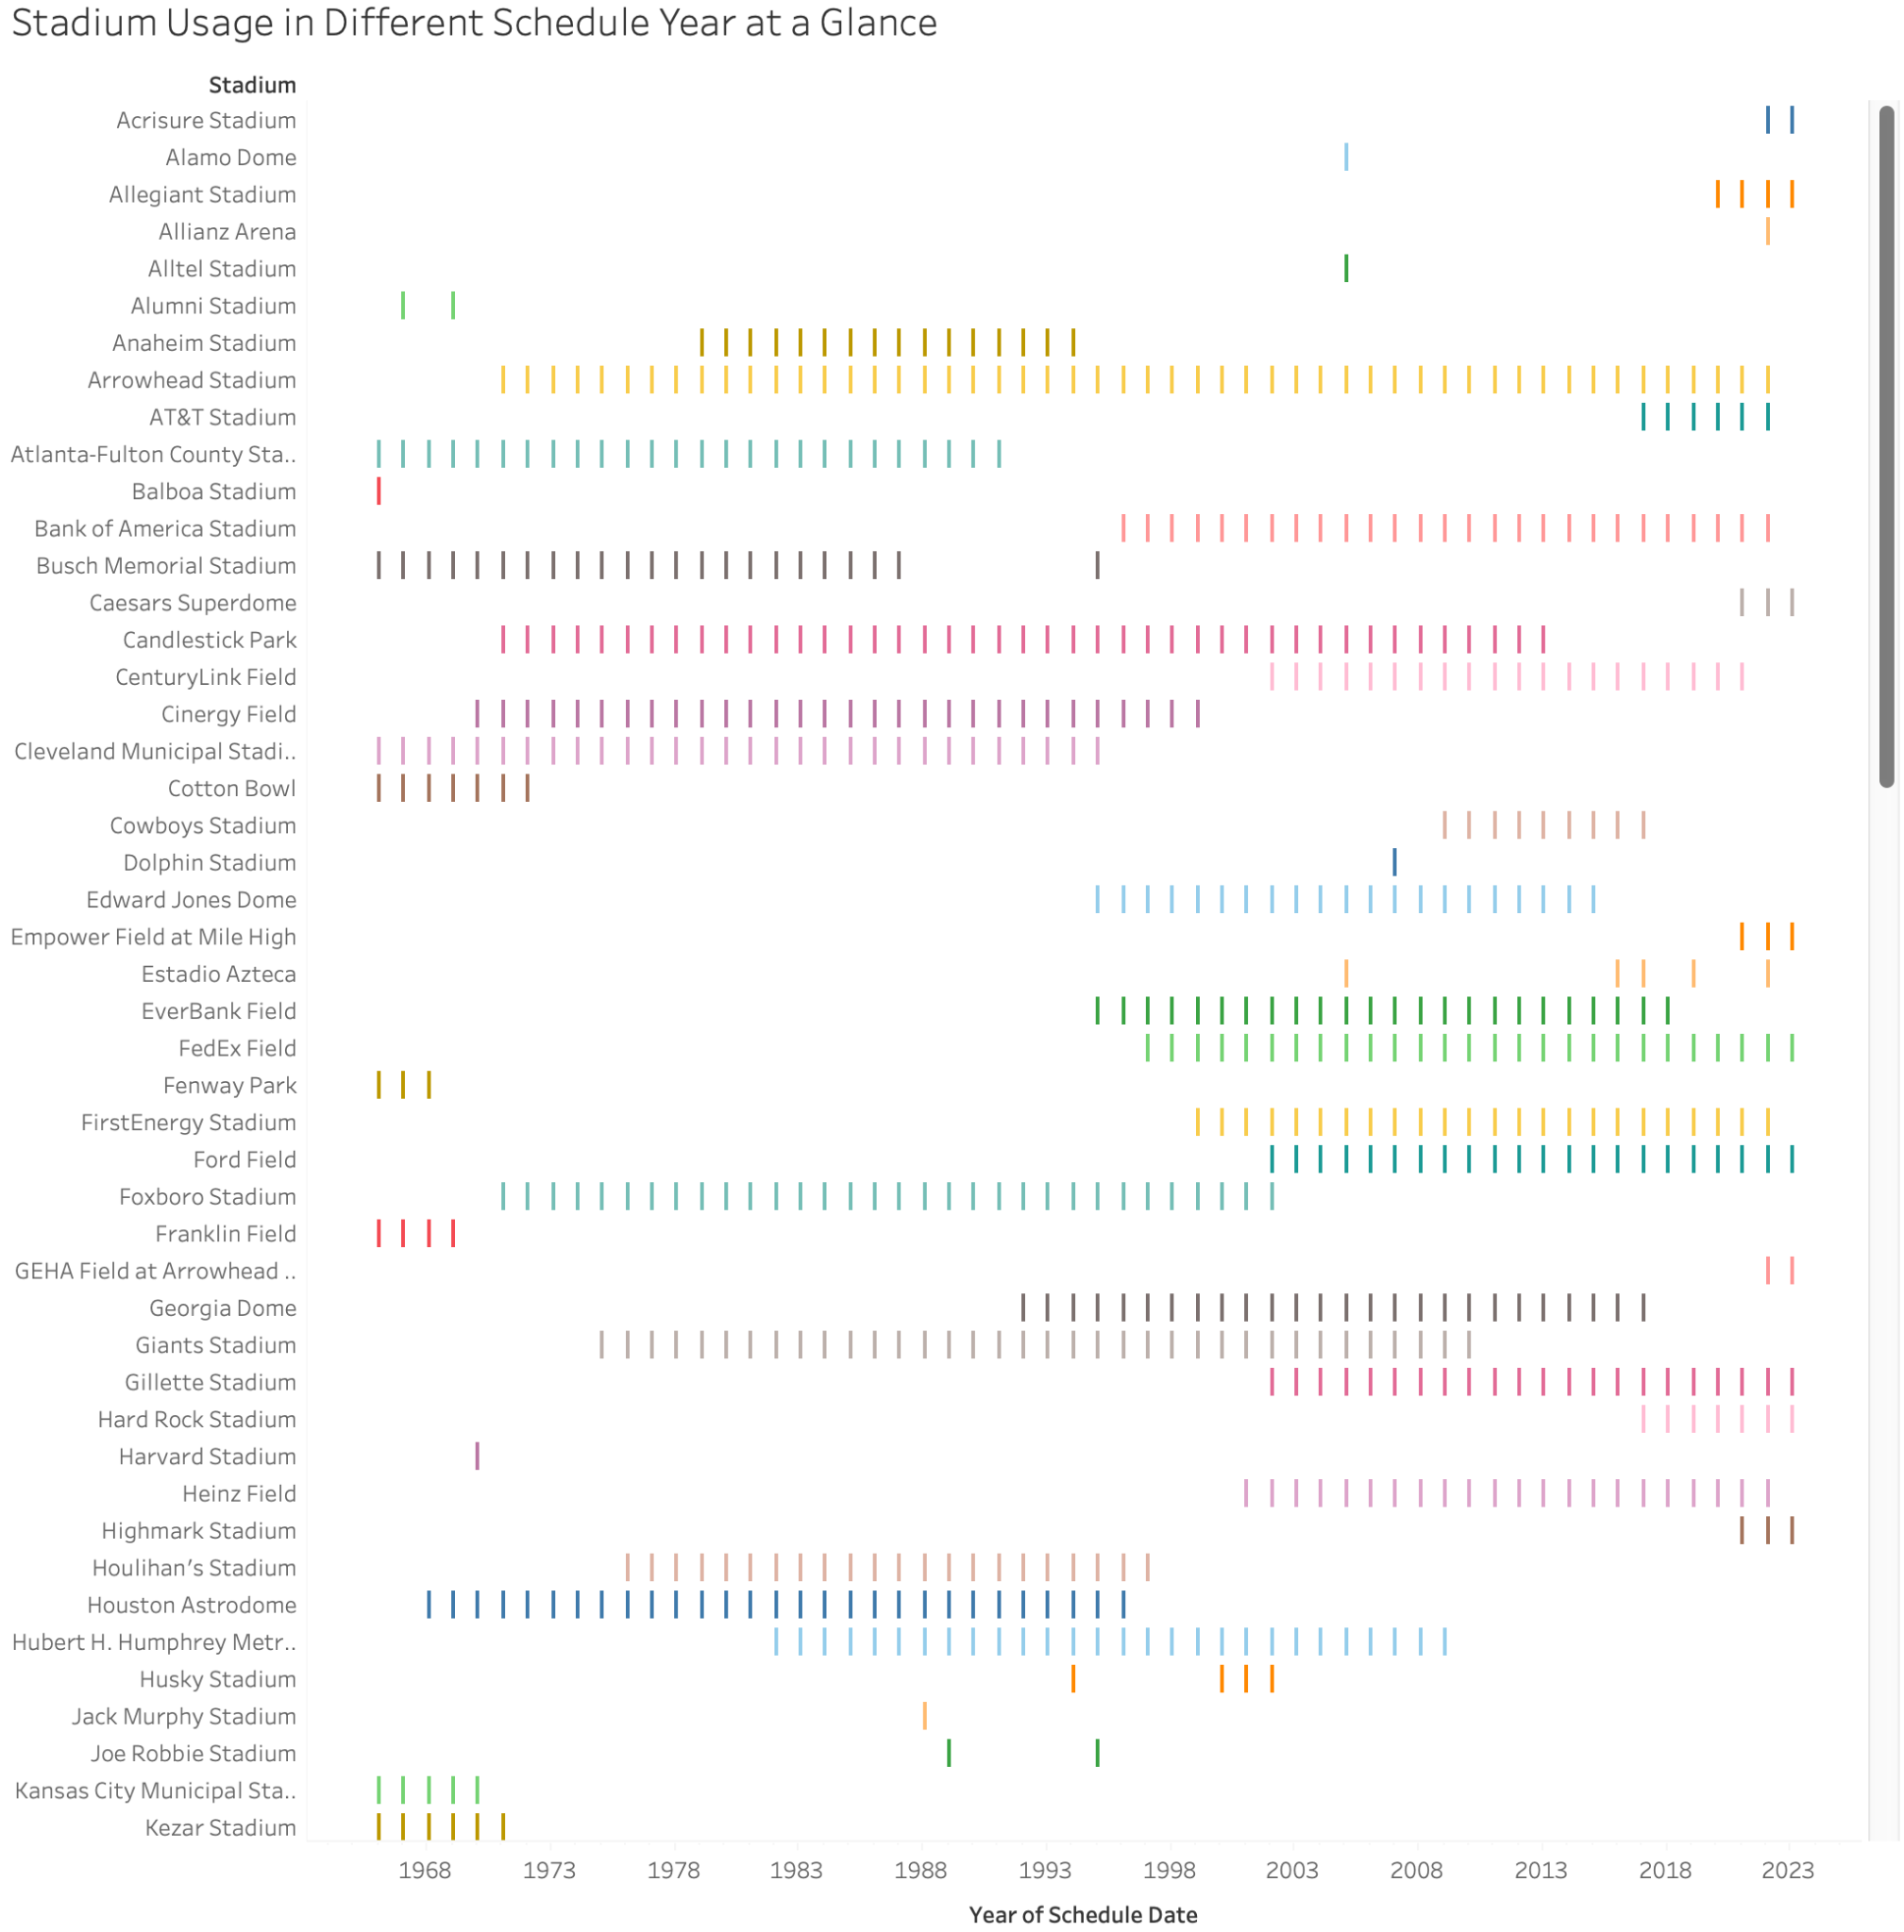
Exploratory Data Analysis - Stadium
Introduction
Data Wrangling
Preliminary Analyses
Advanced Modeling
Web Scraping

Slide 18
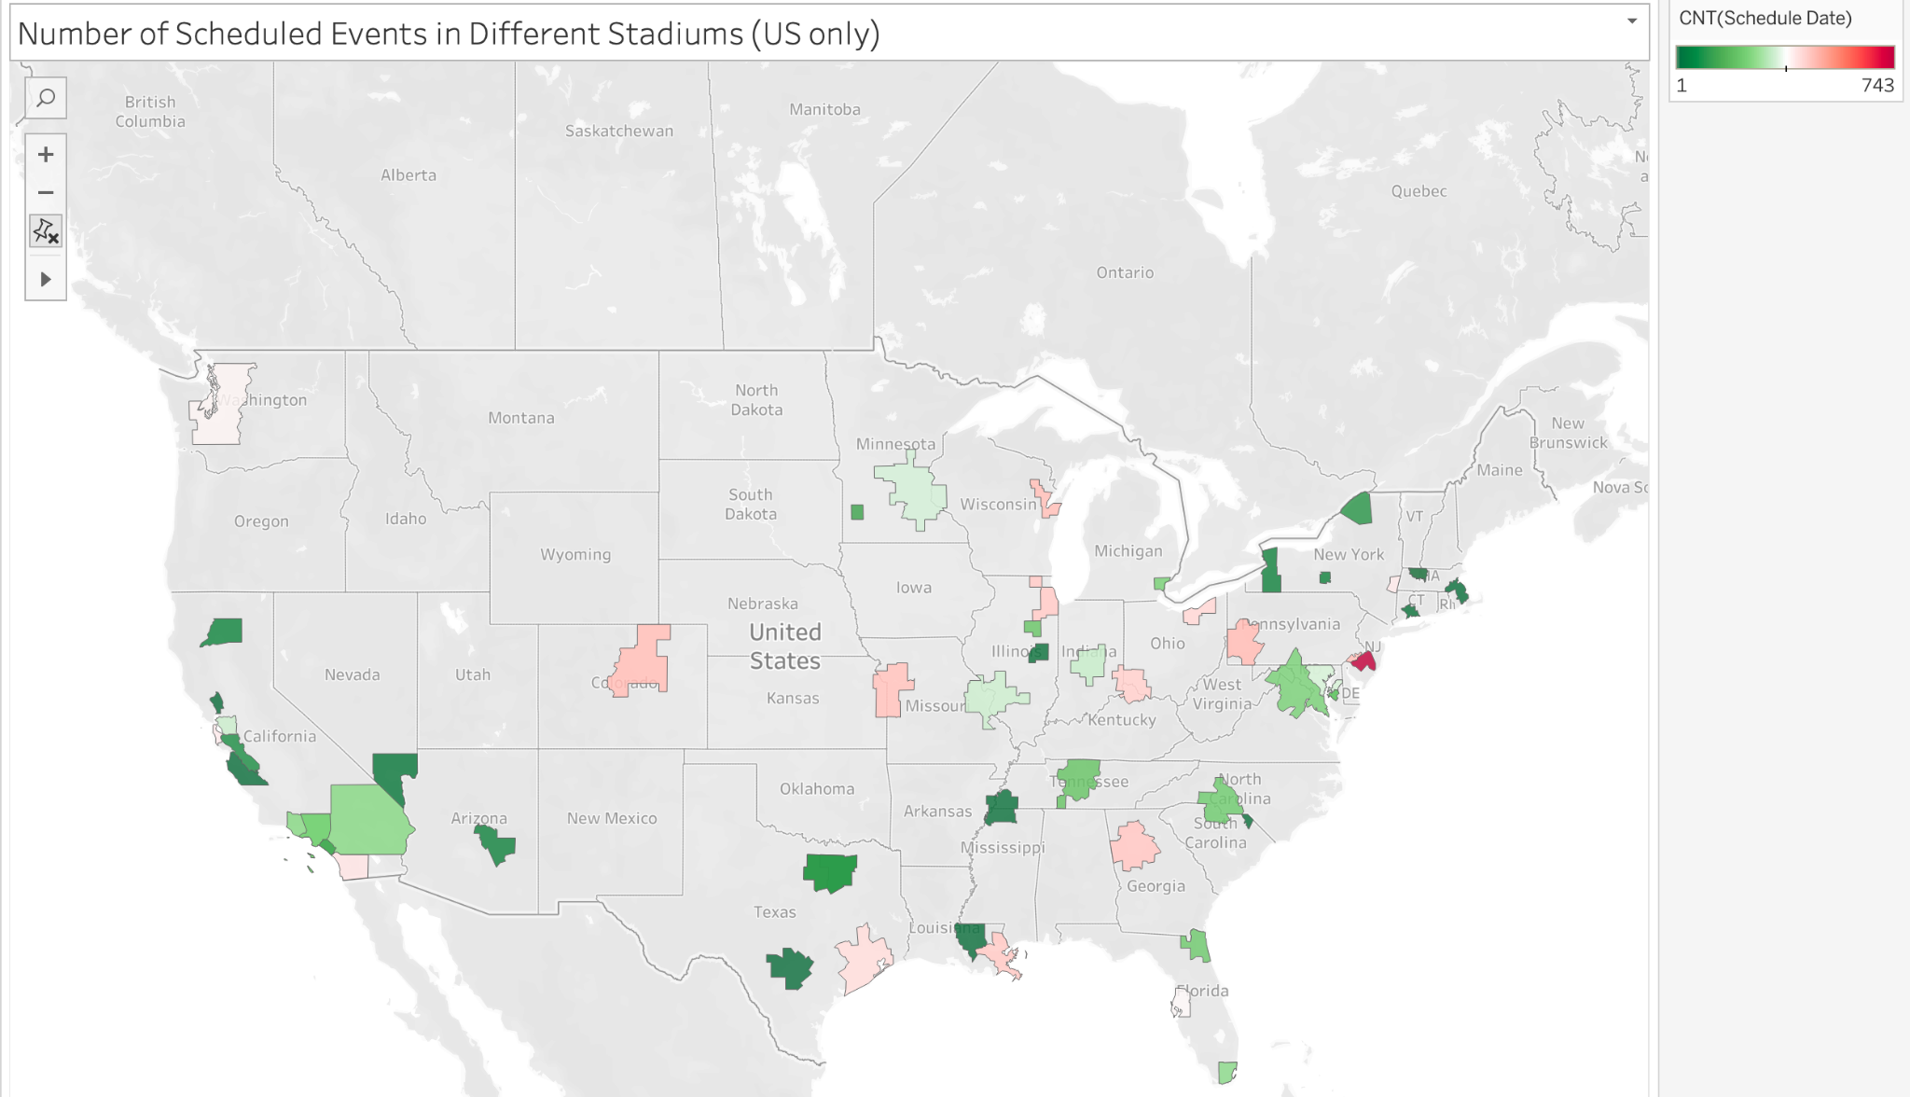
Exploratory Data Analysis - Stadium
Introduction
Data Wrangling
Preliminary Analyses
Advanced Modeling
Web Scraping

Slide 19
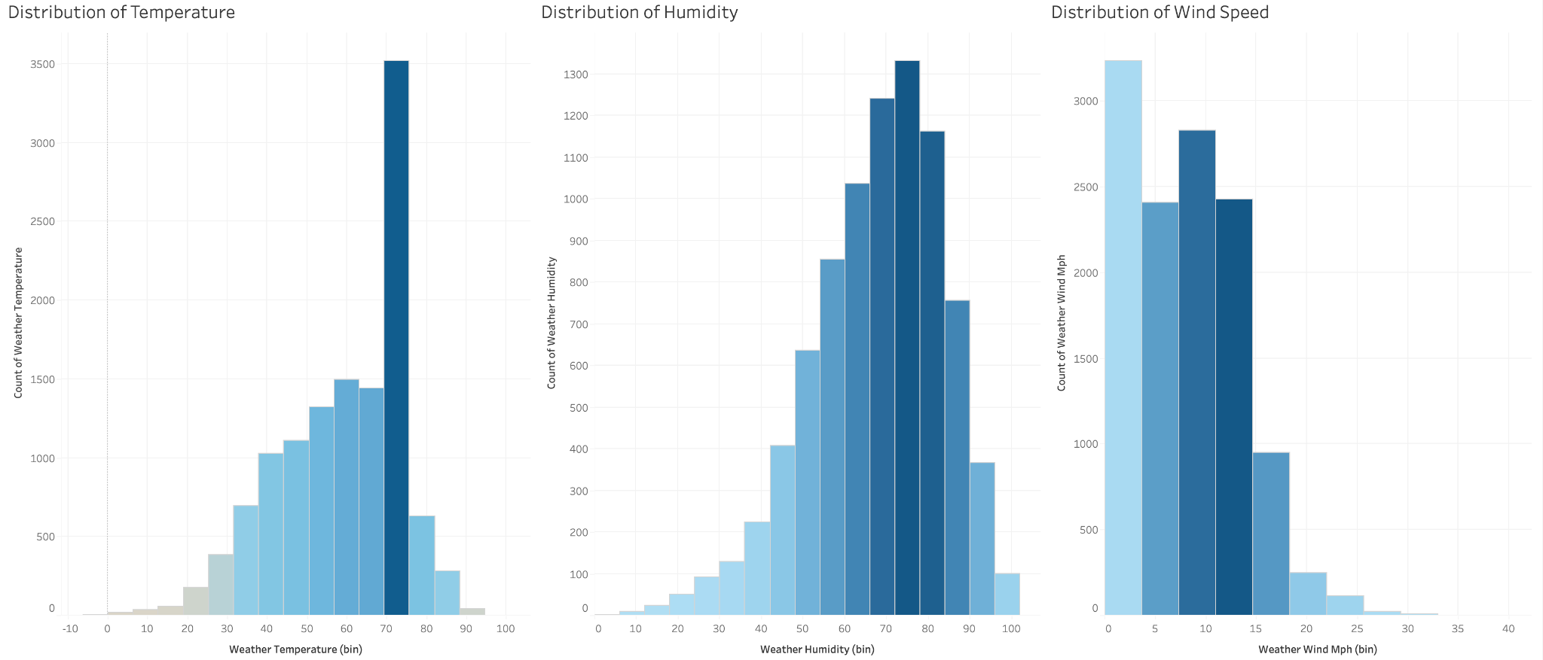
Exploratory Data Analysis - Weather
Introduction
Data Wrangling
Preliminary Analyses
Advanced Modeling
Web Scraping

Slide 20
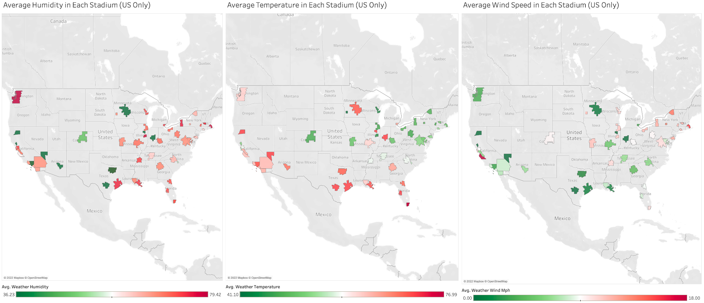
Exploratory Data Analysis - Weather
Introduction
Data Wrangling
Preliminary Analyses
Advanced Modeling
Web Scraping

Slide 21
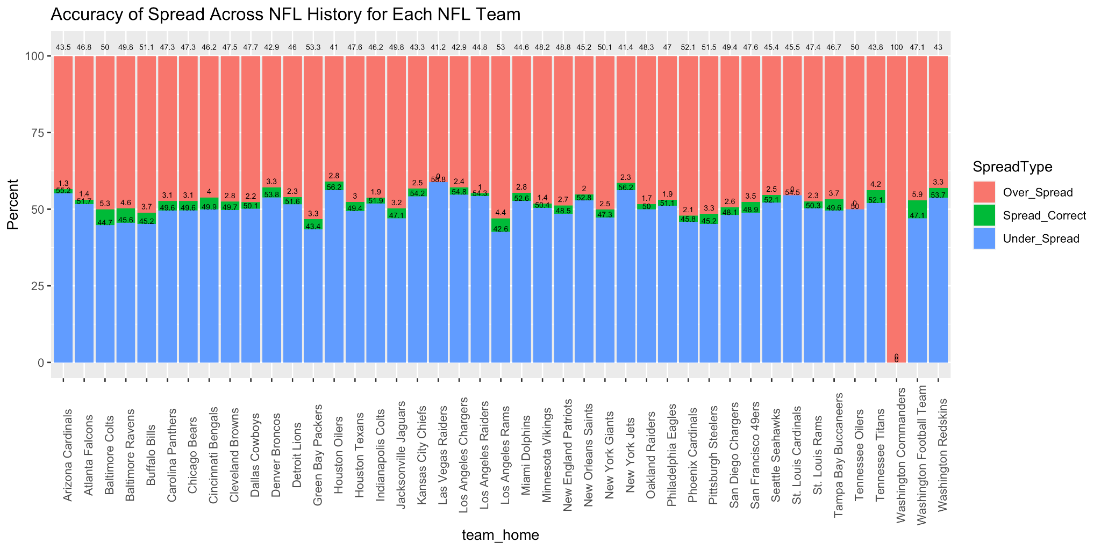
Exploratory Data Analysis - Spread Accuracy
Introduction
Data Wrangling
Preliminary Analyses
Advanced Modeling
Web Scraping
Notes:
Joe’s slide

Slide 22
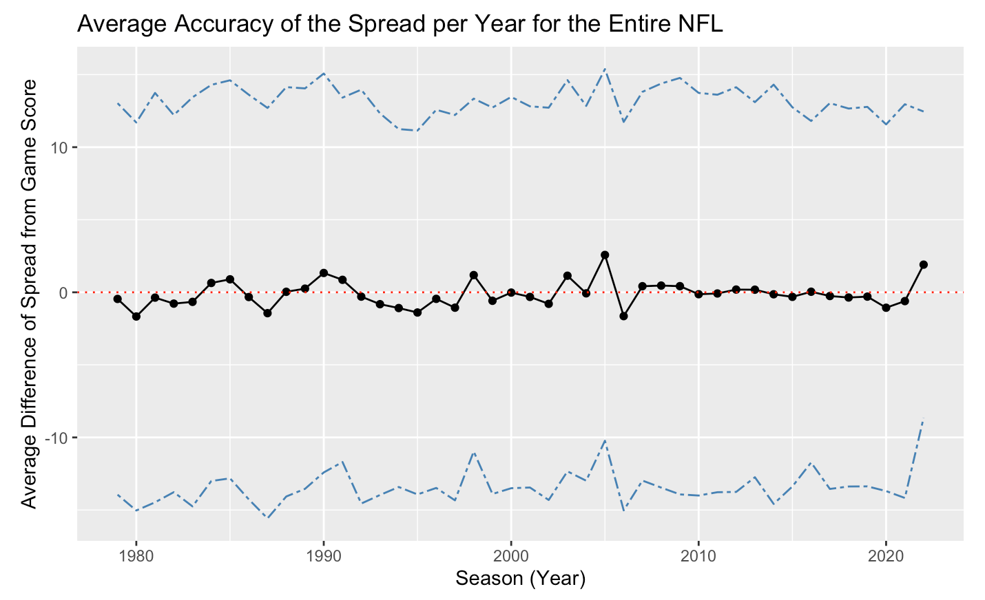
Variation in Spread Accuracy Over Time
Introduction
Data Wrangling
Preliminary Analyses
Advanced Modeling
Web Scraping

Slide 23
Preliminary Analyses:
ii. The effect of weather conditions on the accuracy of the betting spread
Notes:
For the next part, I will be covering our analysis of how different weather conditions affected the accuracy of the betting spread

Slide 24
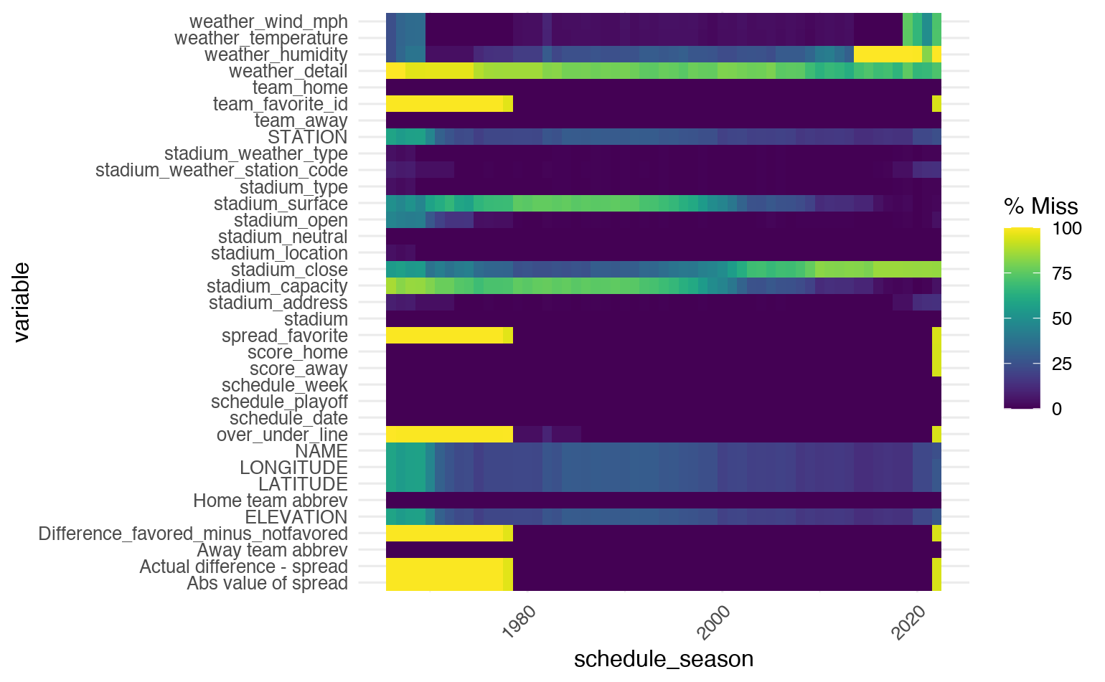
Missing Values
Introduction
Data Wrangling
Preliminary Analyses
Advanced Modeling
Web Scraping
Betting-related data missing pre-1978
Favored team
Spread
Over/under line
Notes:
But, first we needed to take a look at our missing values.
Here is a heatmap to represent where we have missing entries in our dataset, and what we observed is that our data specifically related to betting only goes back as far as the 1978 season, so our analysis only includes data from 1978 until today.

Slide 25
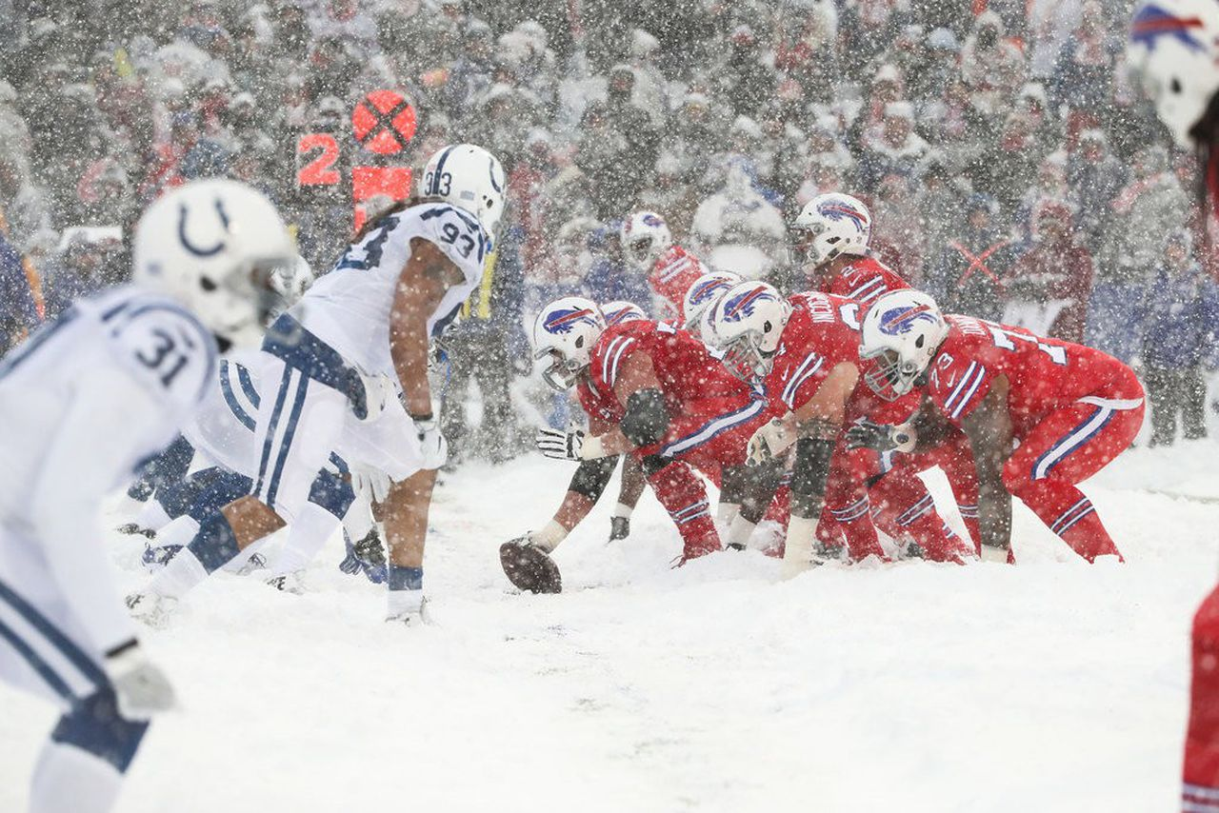
Weather and Football
Go Bills!!!!
Notes:
We are investigating the effect of weather because of the belief that harsh weather conditions like extreme cold or heat, or very strong wind and rain can affect a team’s performance.
If teams aren’t able to perform to their expectations, then maybe it becomes more difficult to predict the score of the game, which is the whole idea behind betting.

Slide 26
Variables related to weather conditions
Outcome variable
Introduction
Data Wrangling
Preliminary Analyses
Advanced Modeling
Web Scraping
Temperature
Wind (mph)
Humidity
Whether or not the stadium has a dome (roof)
Our measurement of the accuracy of the spread
Continuous variables can be visualized in a scatter plot with regression analysis
Notes:
I will be comparing the effect of the weather variables in our dataset against our measurement of the accuracy of the spread.
For almost every game played for every football season, we have information on the temperature, wind, and humidity.
And we also know whether the game was played in a domed stadium, which is meaningful because for games played indoors, there will be no wind, and you can ensure that the temperature is ideal

Slide 27
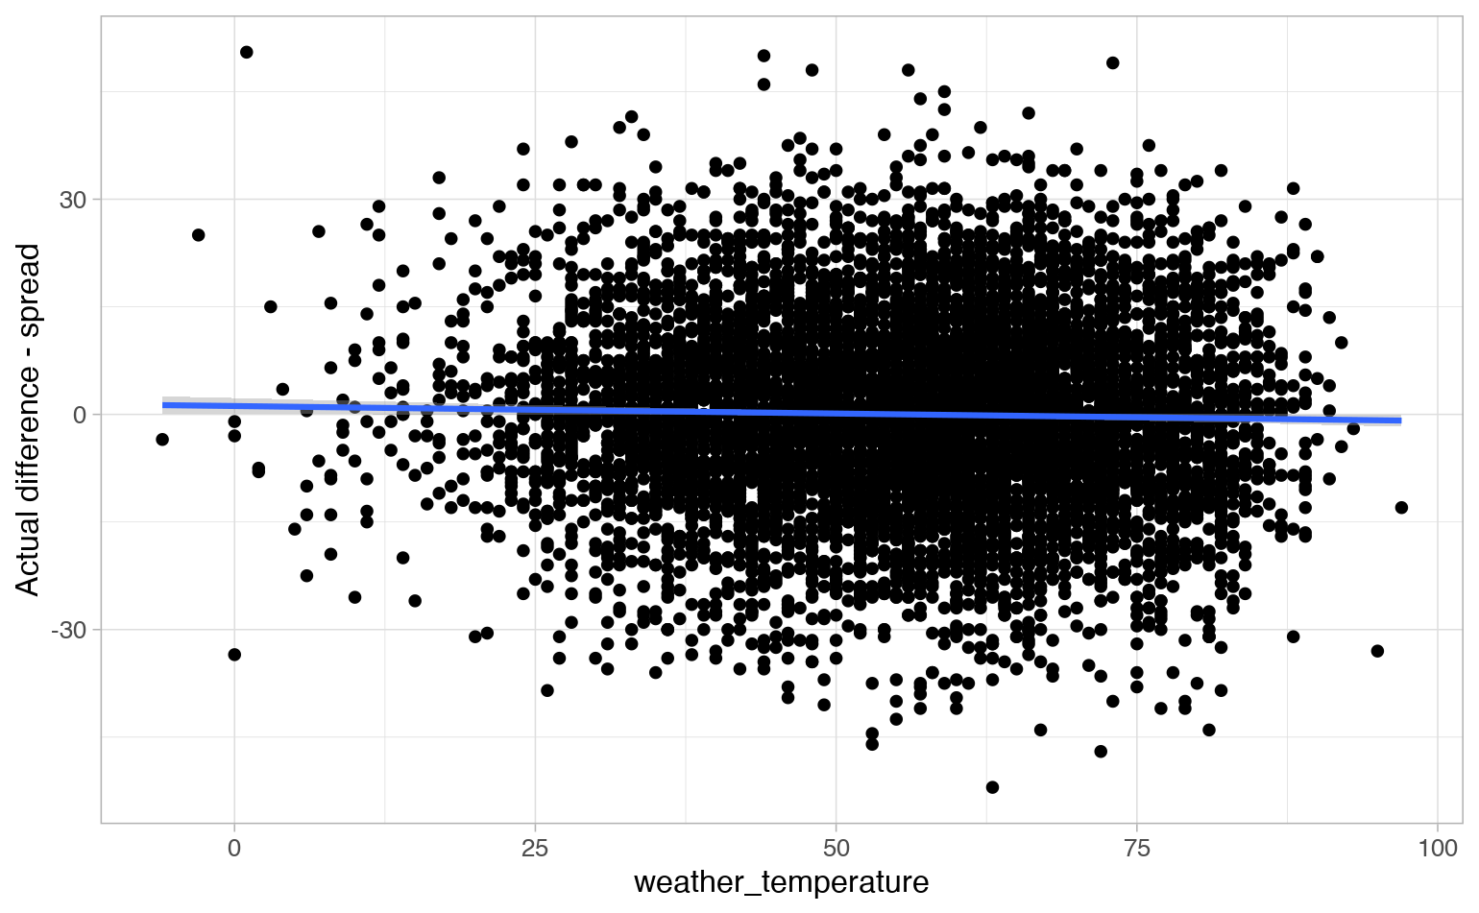
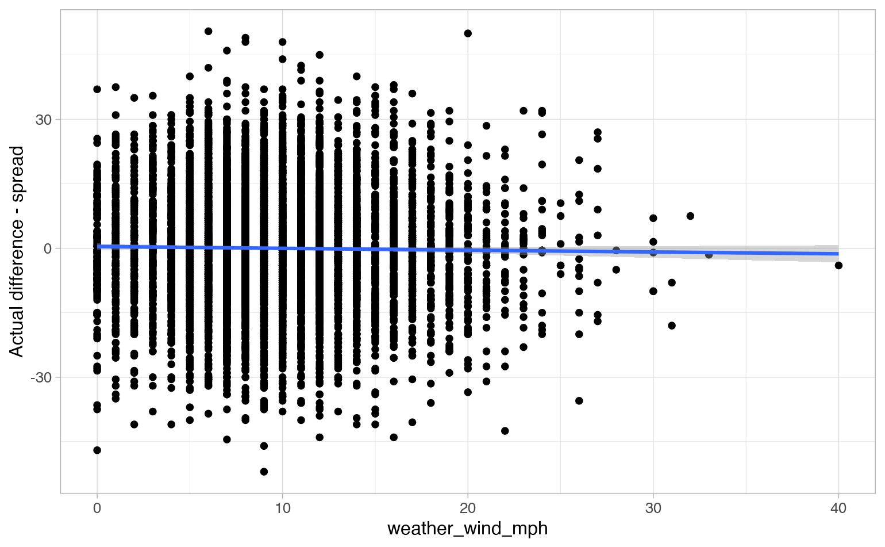
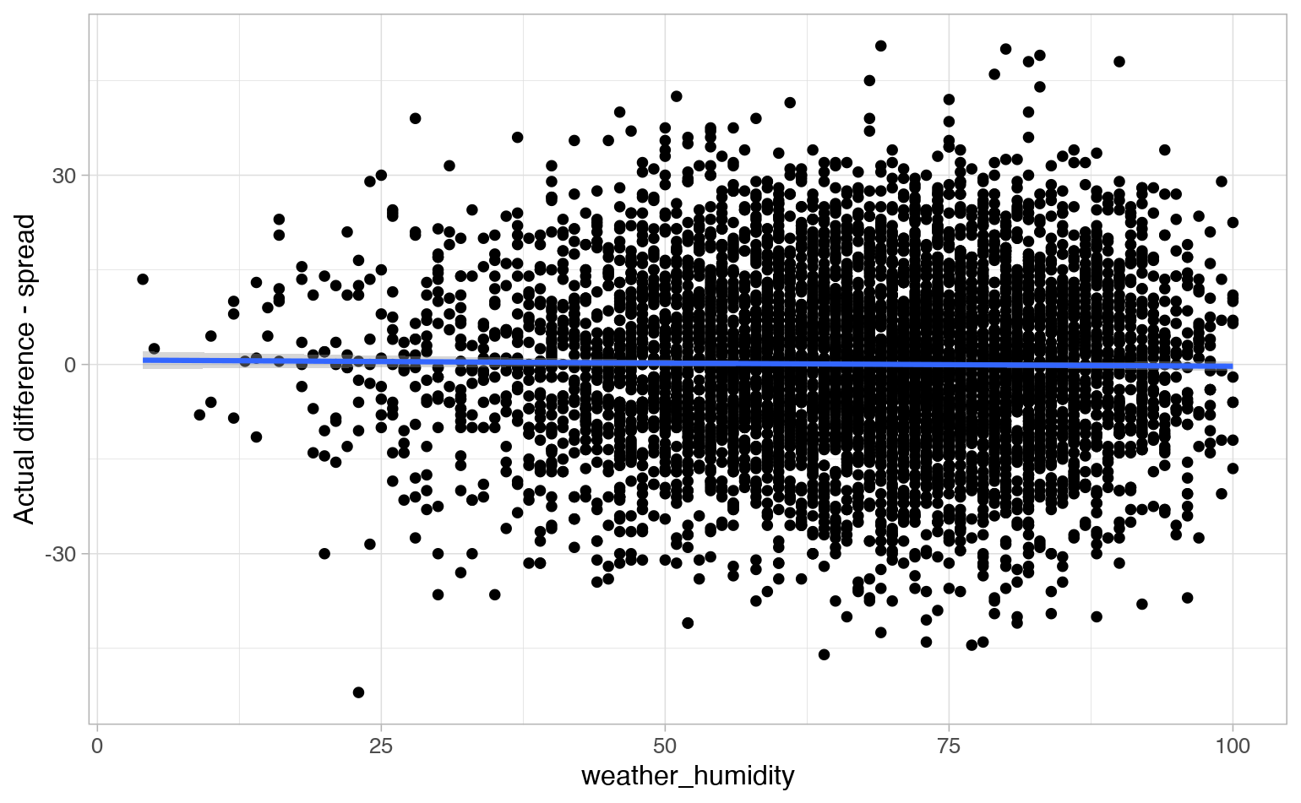
Examining the correlation between weather variables and the accuracy of the spread
Introduction
Data Wrangling
Preliminary Analyses
Advanced Modeling
Web Scraping
Temperature:
r = -0.02477375
Wind:
r = -0.01495849
Humidity:
r = -0.01162643
The spread accuracy is not affected by any of these variables
Notes:
Here are three scatterplots, one for each of temperature, wind and humidity all against spread accuracy. Here we can see that there isn’t any correlation. The slopes are all flat, and the correlation coefficients are tiny. This means that none of these variables alone can bias the accuracy of the spread.

Slide 28
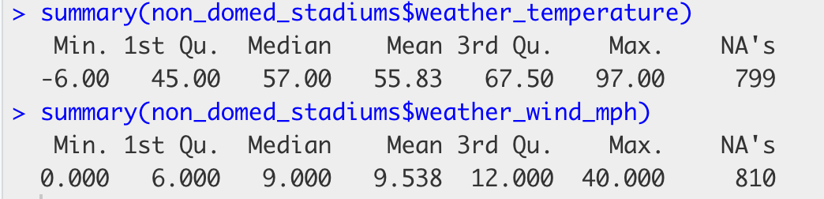
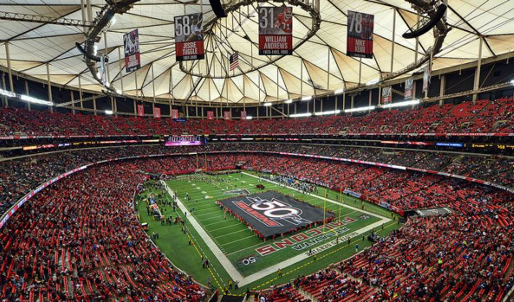
Categorizing weather conditions as “Ideal”, “ok” or “Poor” for playing football
Introduction
Data Wrangling
Preliminary Analyses
Advanced Modeling
Web Scraping
Poor weather (n=1120):
Wind speed > 12 mph AND
Temperature < 45 OR Temperature > 67.5
Ideal weather (n=3536)
Wind speed < 6 mph AND
Temperature between 45-67.5
OR
Domed stadium
Ok weather (n=5276)
Anything else
Notes:
So our next idea was to use those three variables to categorize a game’s weather conditions as poor weather, ideal weather, or ok weather.
To do this we came up with some cutoff values. For example, poor weather is defined as a day where the wind is stronger than 12 mph and the temperature is either below 45 degrees or above 67.5 degrees. These values were chosen by looking at the 1st and 3rd quartiles of our data. So 12 mph corresponds with the our top 25% windiest days. And these temperature values include our 25% coldest days and 25% hottest days.
Ideal weather is defined as our least windy days, and a temperature in the middle 50% of our data. Ideal weather also includes any games played in a domed stadium, because the dome ensures ideal weather.
Anything that wasn’t included in either the poor weather category or the ideal weather category gets put into the ok weather category.

Slide 29
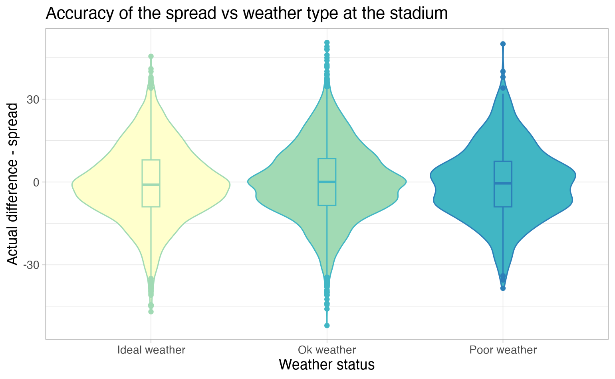
Introduction
Data Wrangling
Preliminary Analyses
Advanced Modeling
Web Scraping
Poor weather:
Wind > 12 mph
Temperature < 45 or > 67.5
Ideal weather
Wind < 6 mph
Temperature between 45-67.5
OR
Domed stadium
Notes:
And here are the results of plotting our weather categories against the accuracy of the spread. Again, there is no difference across the three categories, so we concluded that the weather conditions at a game have no effect on the accuracy of the spread.

Slide 30
Summary of the effect of weather
Introduction
Data Wrangling
Preliminary Analyses
Advanced Modeling
Web Scraping
No observed association between the weather conditions of the game and the accuracy of the betting spread.
The betting spreads that are provided have been well adjusted to account for the effect of weather on the game result
Limitations:
Arbitrary cutoff values for categorization of weather variables
Many other weather conditions were not considered (rain, snow)
Notes:
To summarize this section on weather, we didn’t observe any association between the weather conditions of a game and the accuracy of the betting spread. Our interpretation of this is that the people who decide on the betting spread are very good at adjusting them to account for how the weather on a particular day may affect the result of the game.
There are limitations to this conclusion. 1st, the cutoff values were just chosen out of convenience. We did not validate that our three categories are truly representative of good and bad weather conditions. 2nd, there are other weather conditions that were not included in our dataset, such as the amount of precipitation during a game, which might have been valuable to explore.

Slide 31
Doug Break
Anyone gonna do a question? Bork bork

Slide 32
Advanced Modeling
I. Predictive modeling on the accuracy of the betting spread

Slide 33
Assessing Influence of Weather and Stadium Conditions on Spread Accuracy
Introduction
Data Wrangling
Preliminary Analyses
Advanced Modeling
Web Scraping
Intuition: Can we predict spread accuracy (the difference between an NFL game spread and the actual difference in game score) with a simple linear model?
However, an important assumption of regression is violated: the observations (e.g., individual games) are not independent of one another!
Games are “nested” within teams and season, and the effects of weather/stadium on spread may be different for a given team or year
To address the violation of independence, we can perform a linear mixed-effects model, which allows for the inclusion of both fixed effects (e.g., regular regression terms) and random effects (e.g., regression terms that we allow to vary across groups)
Note: Only complete cases were used (all NAs dropped)

Slide 34
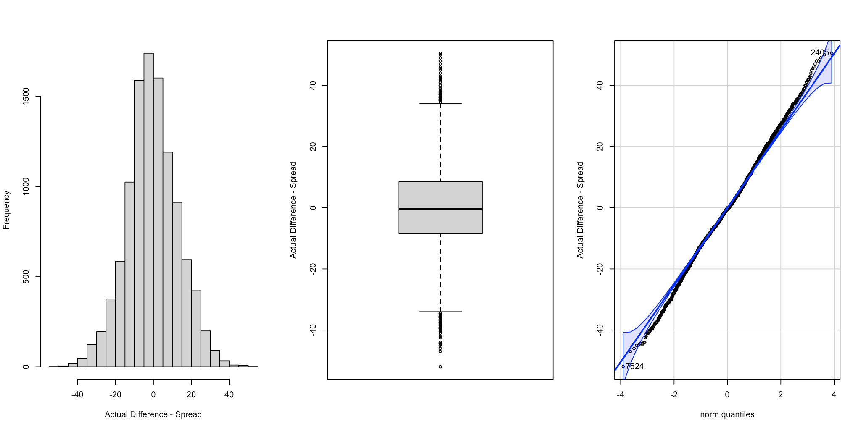
Assessing Normality in Outcome
Introduction
Data Wrangling
Preliminary Analyses
Advanced Modeling
Web Scraping

Slide 35
Linear Mixed-Effects Model Formula
Introduction
Data Wrangling
Preliminary Analyses
Advanced Modeling
Web Scraping
Accuracy_of_Spread = temperature + wind_speed + humidity + weather_type + stadium_design + stadium_weather + stadium_playing_surface + stadium_elevation + (1|schedule_year) + (schedule_year|team)
The orange terms are fixed/main effects - these are the same as we’d see in a normal regression
The green terms are random effects
We have a different (random) intercepts of the model for each year that games were played in, and we also have different slopes for each NFL team that played games.

Slide 36
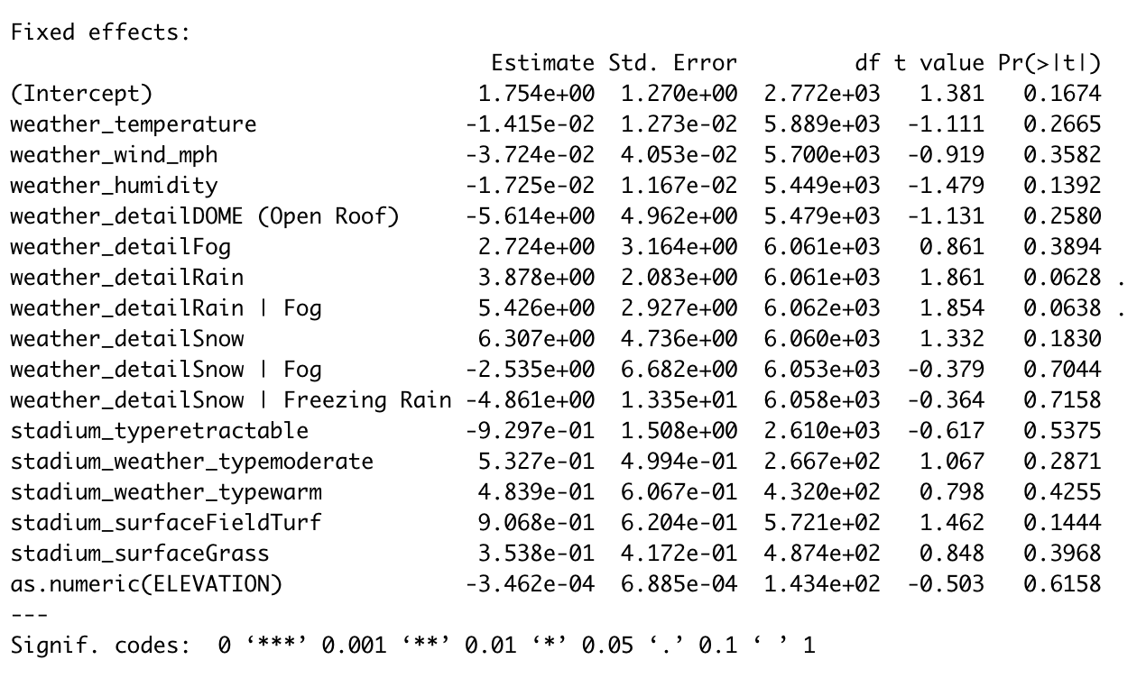
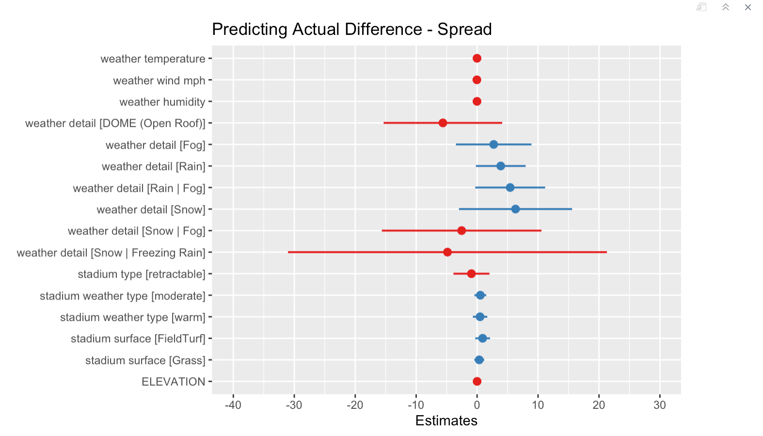
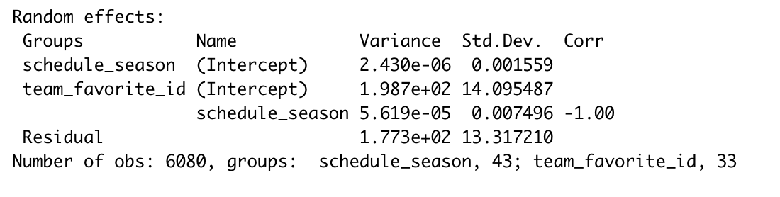
Model Performance and Conclusions
Introduction
Data Wrangling
Preliminary Analyses
Advanced Modeling
Web Scraping
R² = 0.0036 (marginal), 0.0079 (conditional)
No signal! Weather and stadium conditions do not explain any substantial variance in spread accuracy
Model is probably a poor fit, but there is also so much noise in the data

Slide 37
Advanced Modeling
II. Network model of team’s performance against spread

Slide 38
Assessing Historical Team Performance Against Spread with a Network - Intuition
Introduction
Data Wrangling
Preliminary Analyses
Advanced Modeling
Web Scraping
A social network is a representation of relationships between social actors or nodes, with analyses of these networks focusing on the strength of these relationships (represented as edges between nodes)
Nodes: NFL Teams (32)
Edges: Directed - games played between teams where one team was favored over the other
Edge weights: Directed, the proportion of games when the outgoing team was favored that the spread was equaled or exceeded (e.g., actual game score difference ≥ spread)
This representation will allow us to easily visualize the performance of NFL teams against the spread against each other team

Slide 39
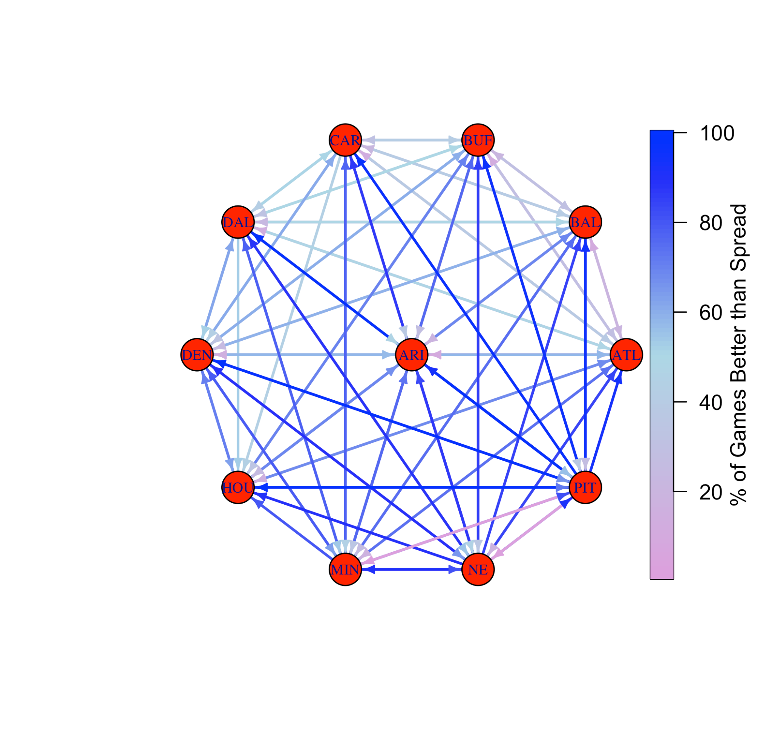
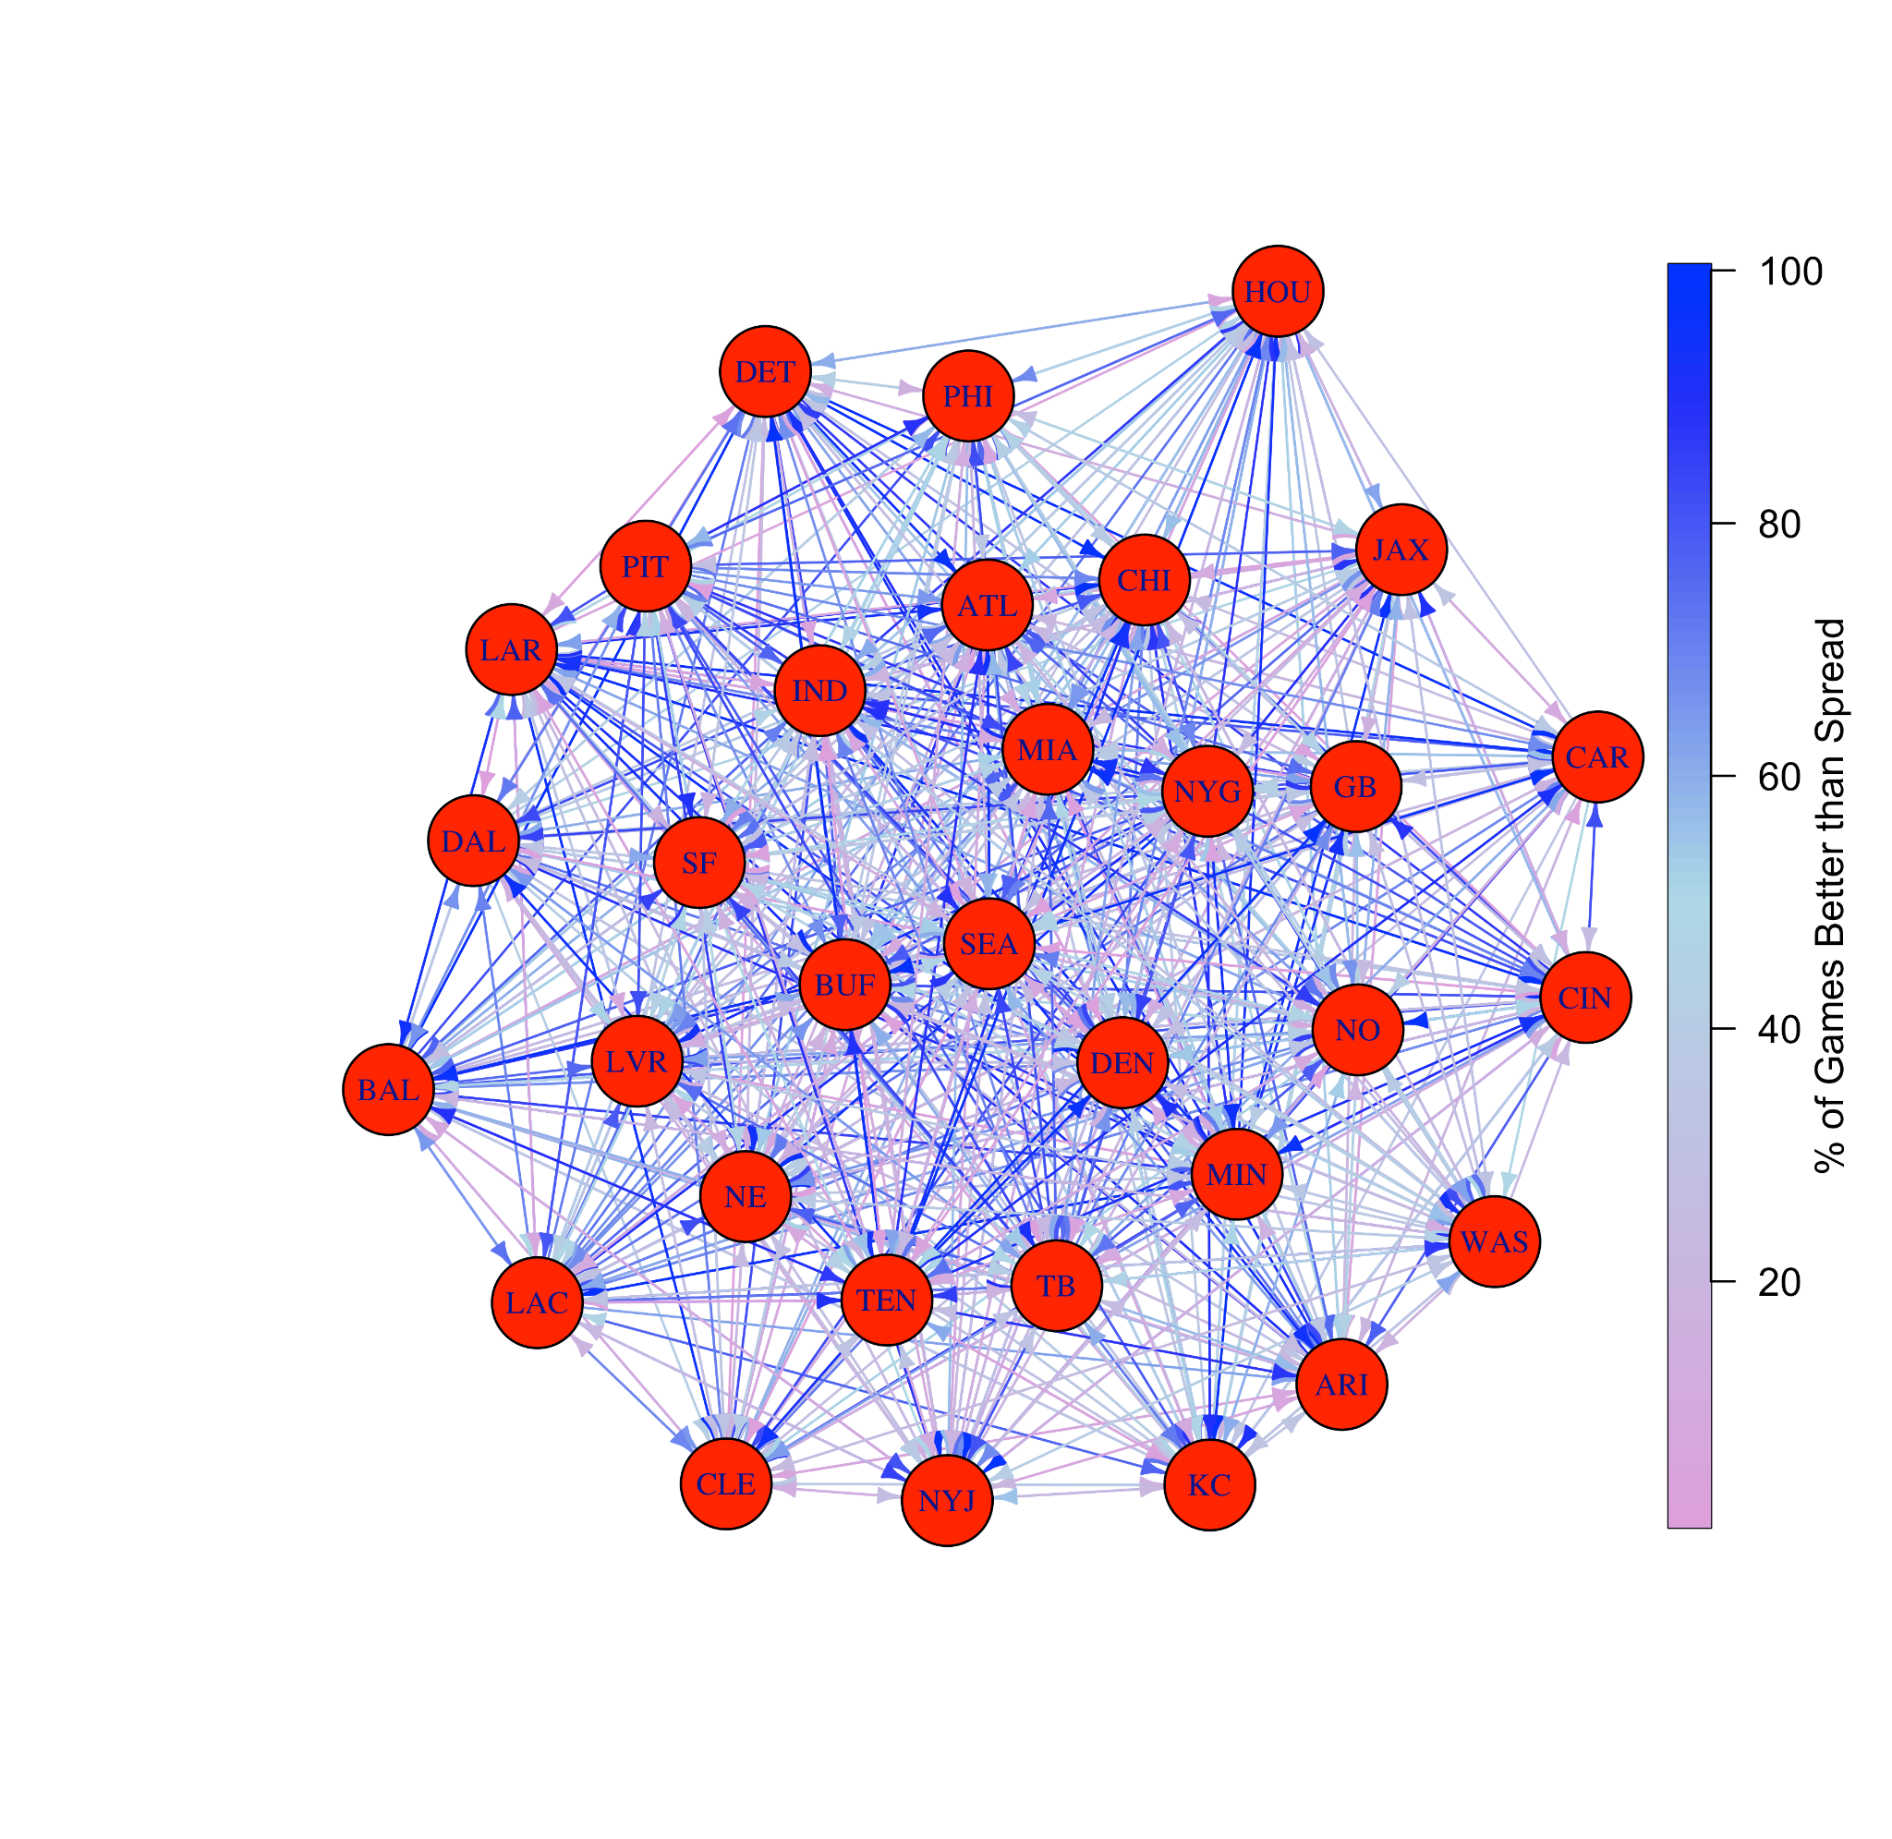
Network Model
Introduction
Data Wrangling
Preliminary Analyses
Advanced Modeling
Web Scraping

Slide 40
Conclusions from Network Model
Introduction
Data Wrangling
Preliminary Analyses
Advanced Modeling
Web Scraping
Only three teams had instances where they’ve never been favored to win against another team historically (Denver → Arizona; Philadelphia → Houston; Green Bay → Jacksonville)
The majority of teams (21) equal or exceed the spread >50% of the time on average, with Baltimore (61.3%), Green Bay (59.5%), and Buffalo (55.8%) performing the best
Based only on historical data, these teams might be the best to bet on
Atlanta (46.3%), Las Vegas (47.1%), and New York (48.3%) are the worst on average when it comes to equalling or exceeding the spread
Might be best to bet against these teams!

Slide 41
Web Scraping Supplementary Weather Data

Slide 42
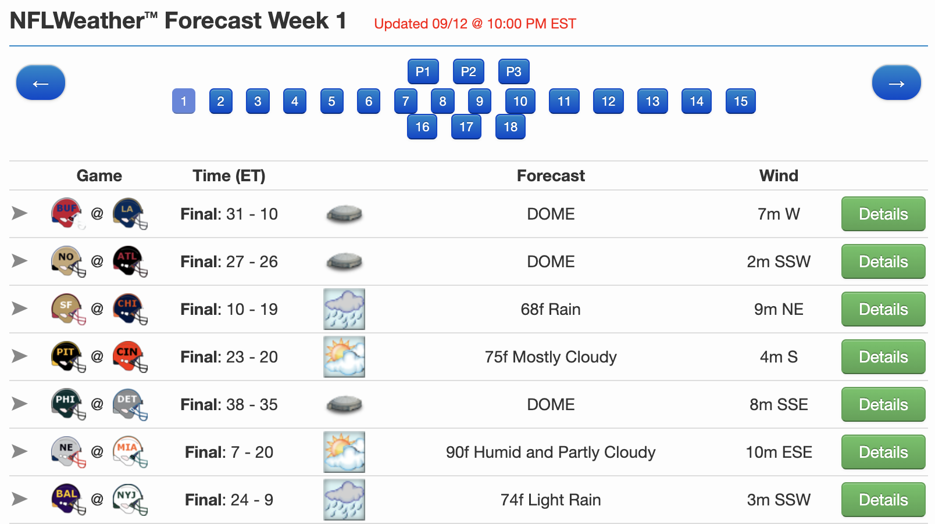
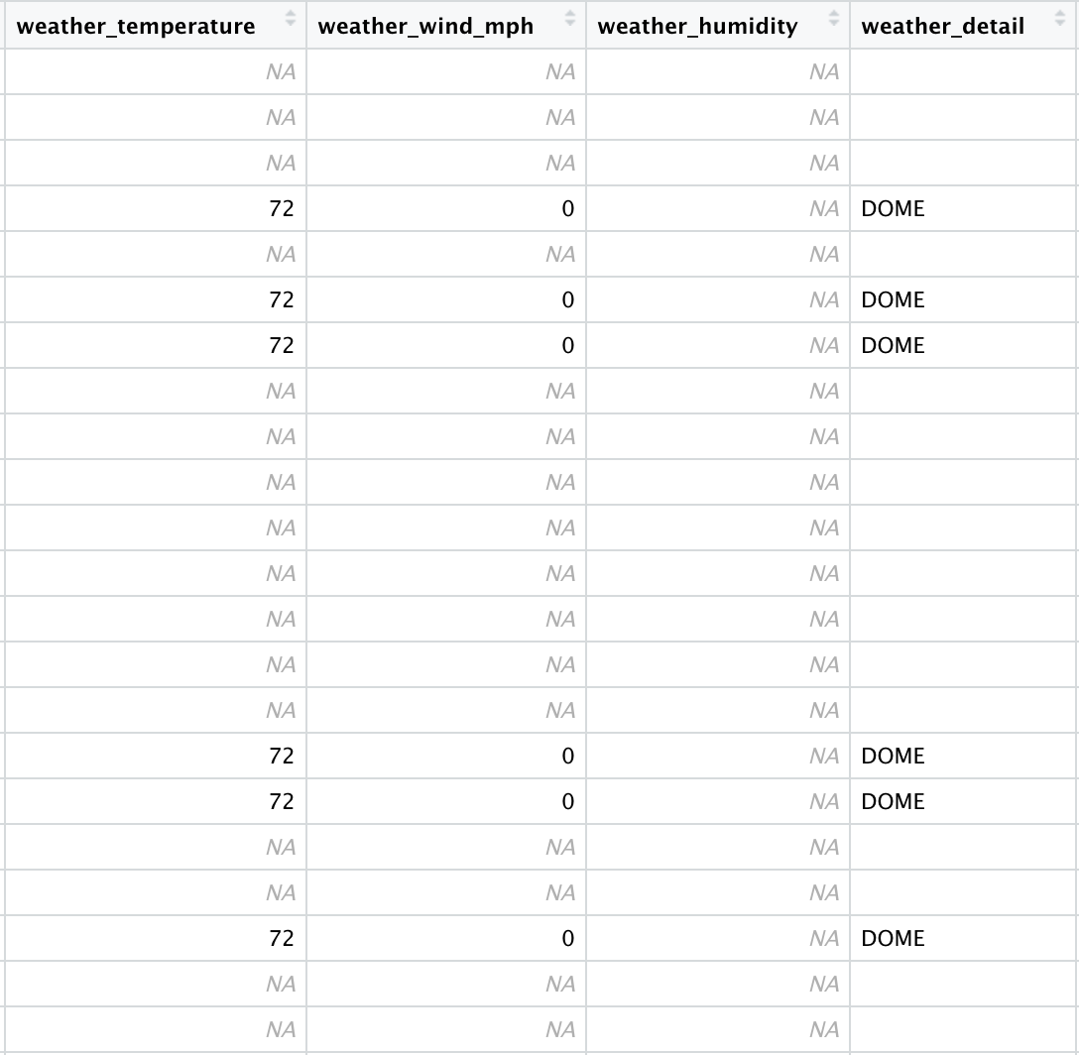
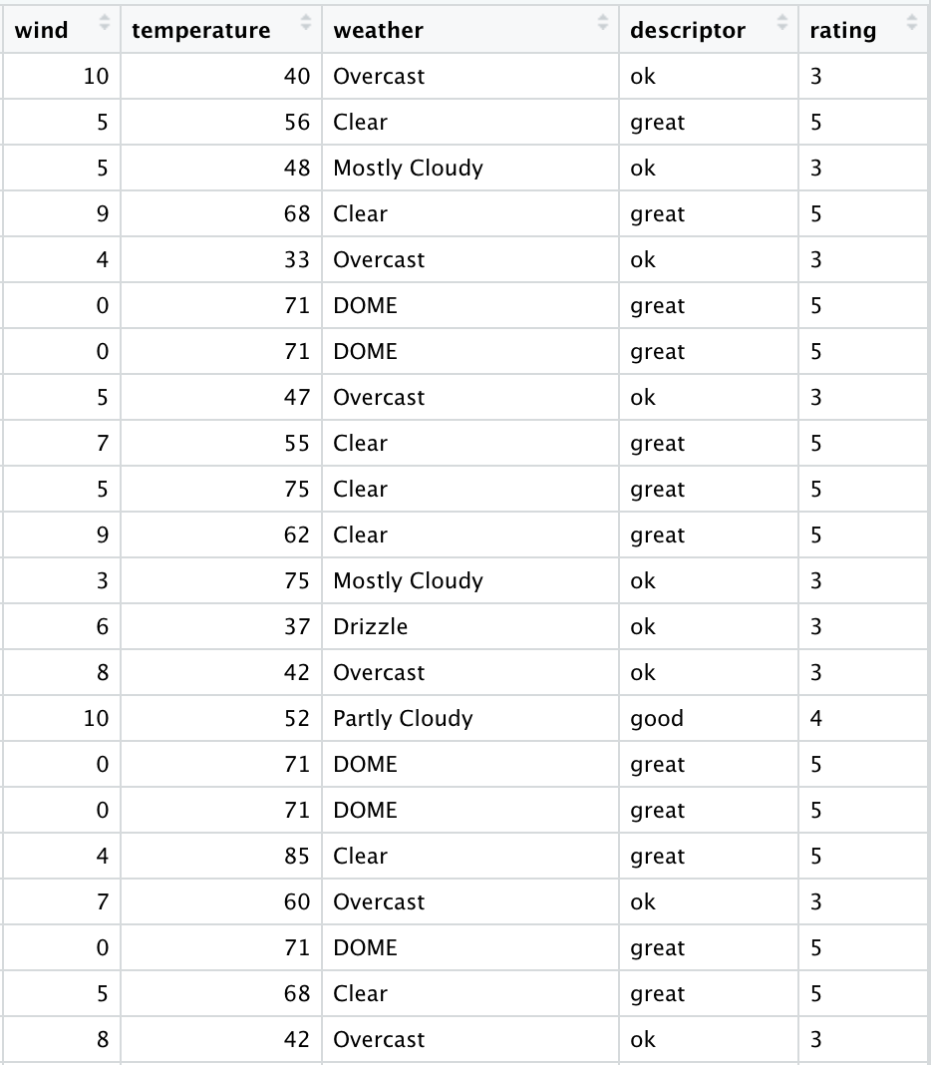
Scraping Weather Data for Missing Values
Introduction
Data Wrangling
Preliminary Analyses
Advanced Modeling
Web Scraping
Sourced weather data from http://nflweather.com/ which had temperature, wind and forecast details from 2011-2021

Slide 43
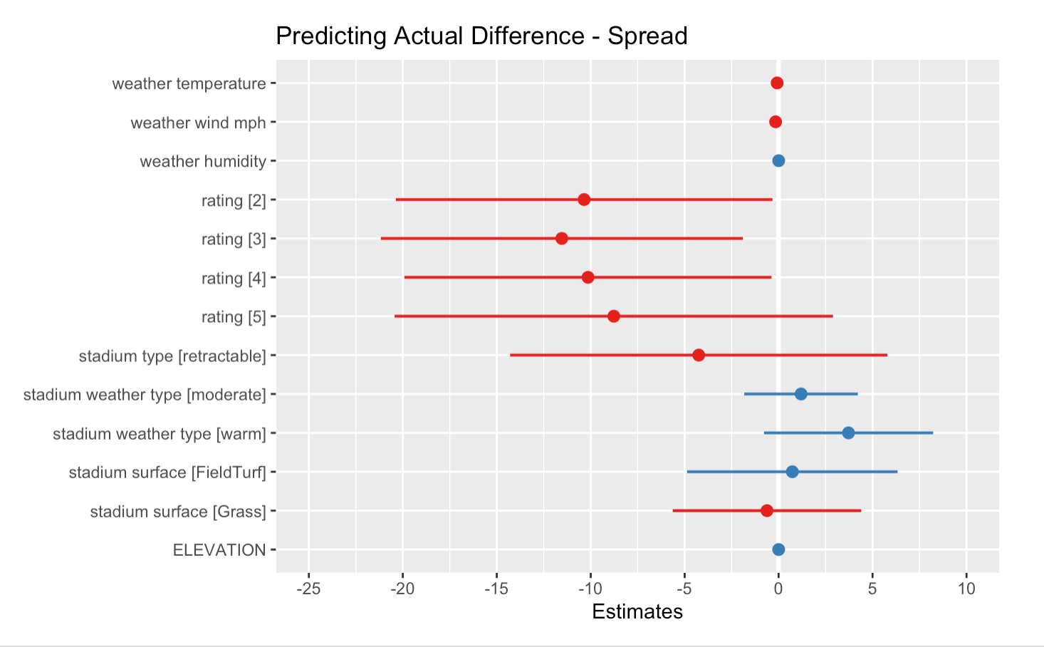
Re-Running the Linear Mixed-Effects Model
Introduction
Data Wrangling
Preliminary Analyses
Advanced Modeling
Web Scraping
Before: R² = 0.0036 (marginal), 0.0079 (conditional)
After: R² = 0.0289 (marginal), 0.1265 (conditional)
Still not good, but reflects small improvement

Slide 44
Conclusions, Next Steps, Limitations

Slide 45
Closing Remarks
Conclusions in relation to our aims
Despite great game-to-game variation in the accuracy of the spread, on average, the spread seems to be fairly consistent with true game scores and has been throughout NFL history
Weather and stadium data do not seem to relate to the accuracy of the spread
Historically, might be best to bet on Baltimore and not on Atlanta
Limitations
Lots of missing weather data – we chose not to impute
The NIH would not approve our grant proposal, so we could not see this project to its full potential (just kidding)
Future work
We did not examine data related to over/under
We could rerun the present analyses with more expansive weather data for all years (were unable to due to time constraints)
We could repeat these analyses on another professional sport, should data be available
Kevin will use these models and see a therapist about his gambling addiction

Slide 46
Thank you! - Team DougFans

